Slide 1
Reflecting God’s Love @Work
Courageous Third
Why are Faith ERGs of value?
To COMPANIES
To EMPLOYEES
Craig Carter
craig.carter@courageousthird.org
www.CourageousThird.org
Notes:
Reflecting God’s Love at Work. 2021.
Craig – Intel 25yrs, Product Manager/Fin Controller, Christian/Cross-Faith ERG, Fortune 100…(Project Manager – Sikh, Hindu coworker, Salesforce)
The Strategy to achieve the Goal.
It is happening, it now just needs structure and fuel so it accelerates quickly
Your life at work will be full of “Abundant Joy” and you will also “Change the World”
Feedback desired! At wait/pray stage…

Slide 2

Results: Require cultivating Good Soil/Environment
    The top two reasons employees leave their jobs is;
    lack of feeling valued and a sense of belonging.
    McKinsey & Company
How important is Faith/Belief to employees?
Notes:
Slide used internally in 2021 – when 15 Intel VPs agreed this is something we should pursue.

Slide 3
Faith and Belief is Critical to Employees
Faith & Belief Affiliation
(Pew Research)
Authentic Culture Drives Results:
(Harvard Business Review)
USA 84%
Globally Growing
Authentic Vulnerable Leadership
Creates...
87%
50%
Higher
Performance
76%
Higher
Engagement
83%
106%
More
Energy
74%
Less
Stress
29%
Higher Life
Satisfaction
Employees want to be AUTHENTIC at work. Be Valued. To Belong.
They will seek it out and go to companies that are.
Sources:
% Religious Pie Chart: Pew Research
% Religion is “Very Important” Chart: Pew Research
It all starts with Trust data: Harvard Business Review, March 2021
Notes:
Slide used internally in 2021 – when 15 Intel VPs agreed this is something we should pursue.

Slide 4
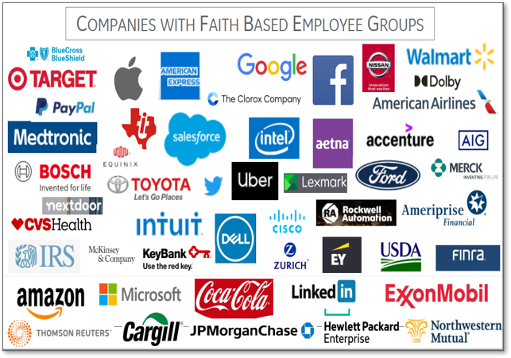
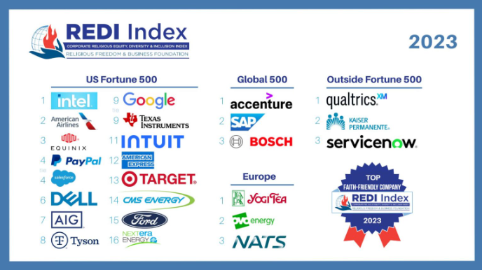
Who is doing it?
Is your company a leader in diversity?
Notes:
Slide used internally in 2021 – when 15 Intel VPs agreed this is something we should pursue.

Slide 5
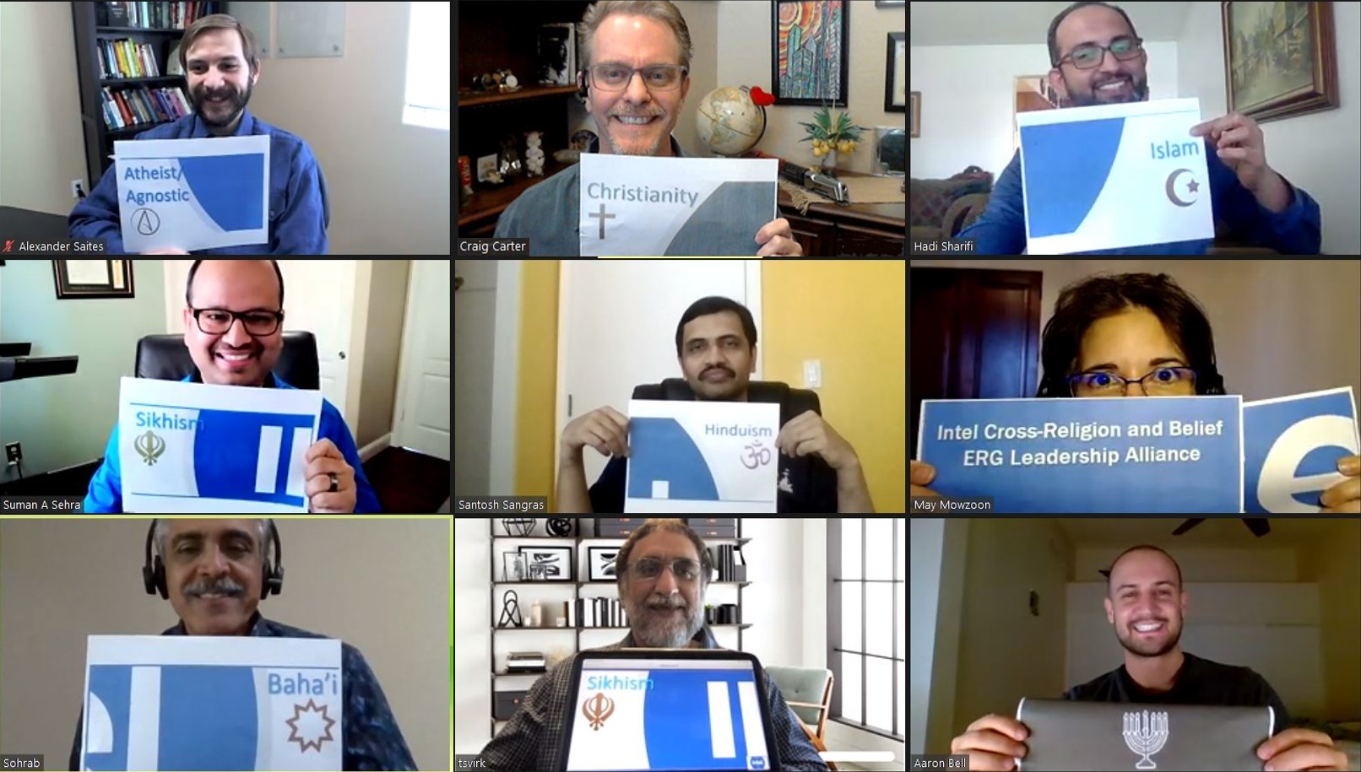
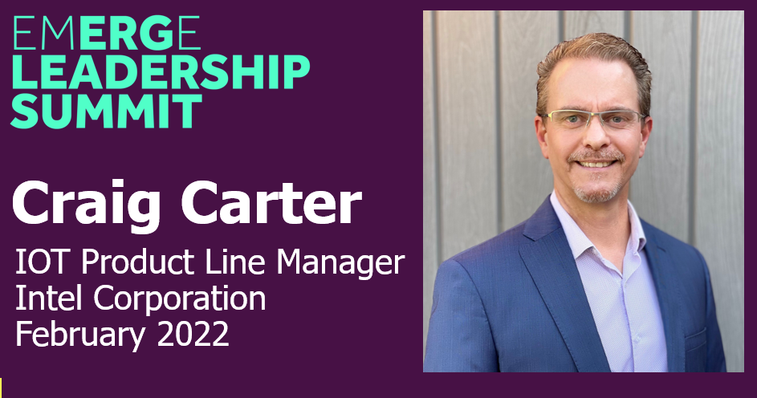
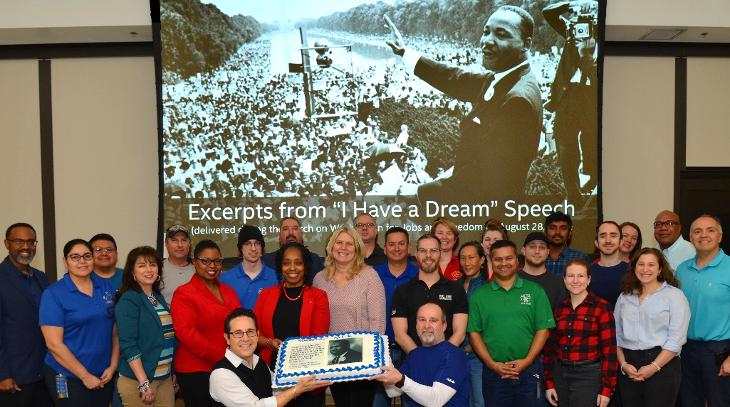
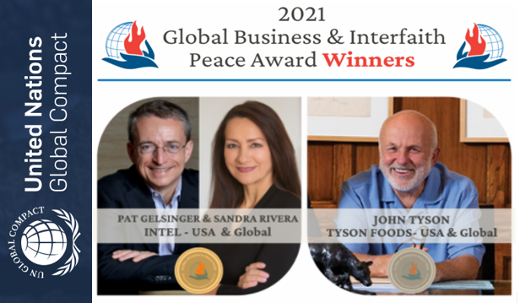
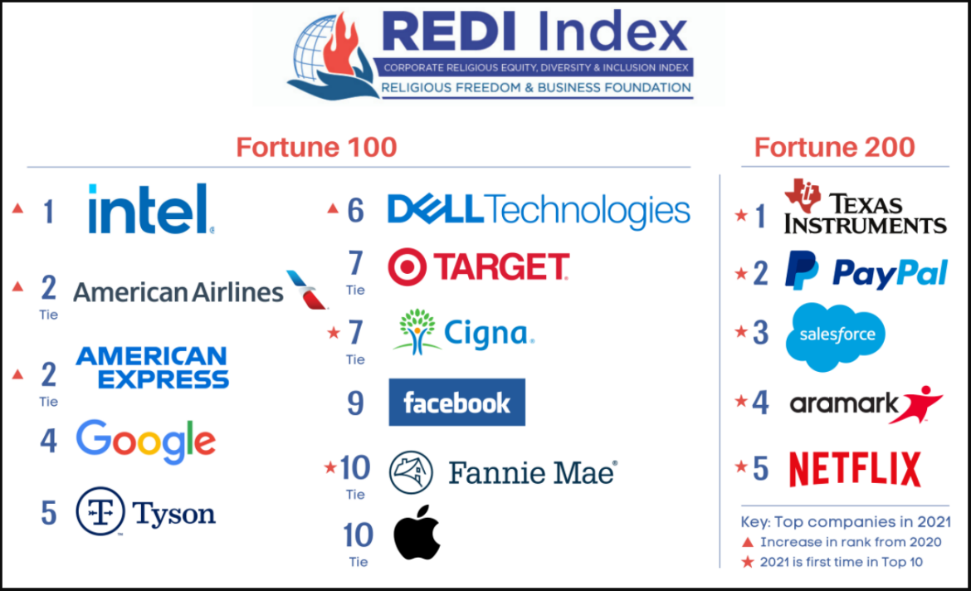
Example: Intel is a Leader in Faith/Belief Inclusion
Faith/Belief Inclusion
Intel #1 in Fortune 100, 25yrs+
Atheist, Baha’i, Christian, Hindu, Jewish, Muslim, Sikh
Intel won the Cross-Faith ERG award at the EMRGE Leadership Summit in 2022
Racial/Ethnic Unity, 6yrs

Slide 6
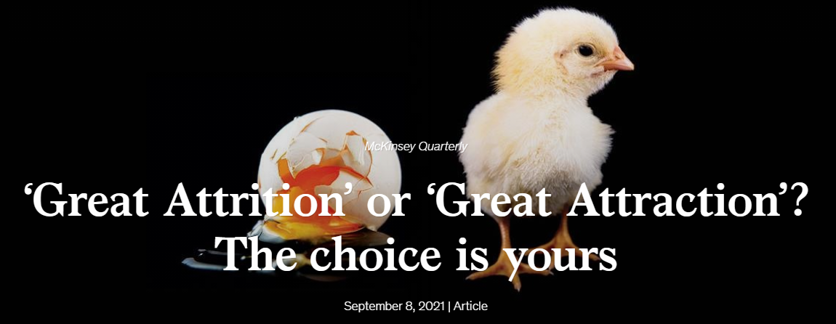
Value to Companies – The Three “R’s”
    Recruiting
Having Faith ERGs improves recruiting.
Employees seek out places where they are welcomed.
    Retention
People STAY – when they are welcomed and have friendships!
“Even though I received 2 better job offers from big companies,
I am not leaving here. They do not have any Faith groups, here we do!”
- Druiz Employee at Intel Corporation, in Israel
    Results
Results. The best teams are Authentic teams!
People want to be heard, seen. Agreement is secondary. Teams that can be real, can solve problems better and more aggressively – as the foundation of trust is there.

Slide 7

The wave may look big… but surfing it is GLORIOUS!
Truly… best part of my career is caring about people at work.
Reach out! We are here to help you.
Craig Carter and The Courageous Third team
craig.carter@courageousthird.org | www.CourageousThird.org
This Photo by Unknown Author is licensed under CC BY-NC

