Slide 2
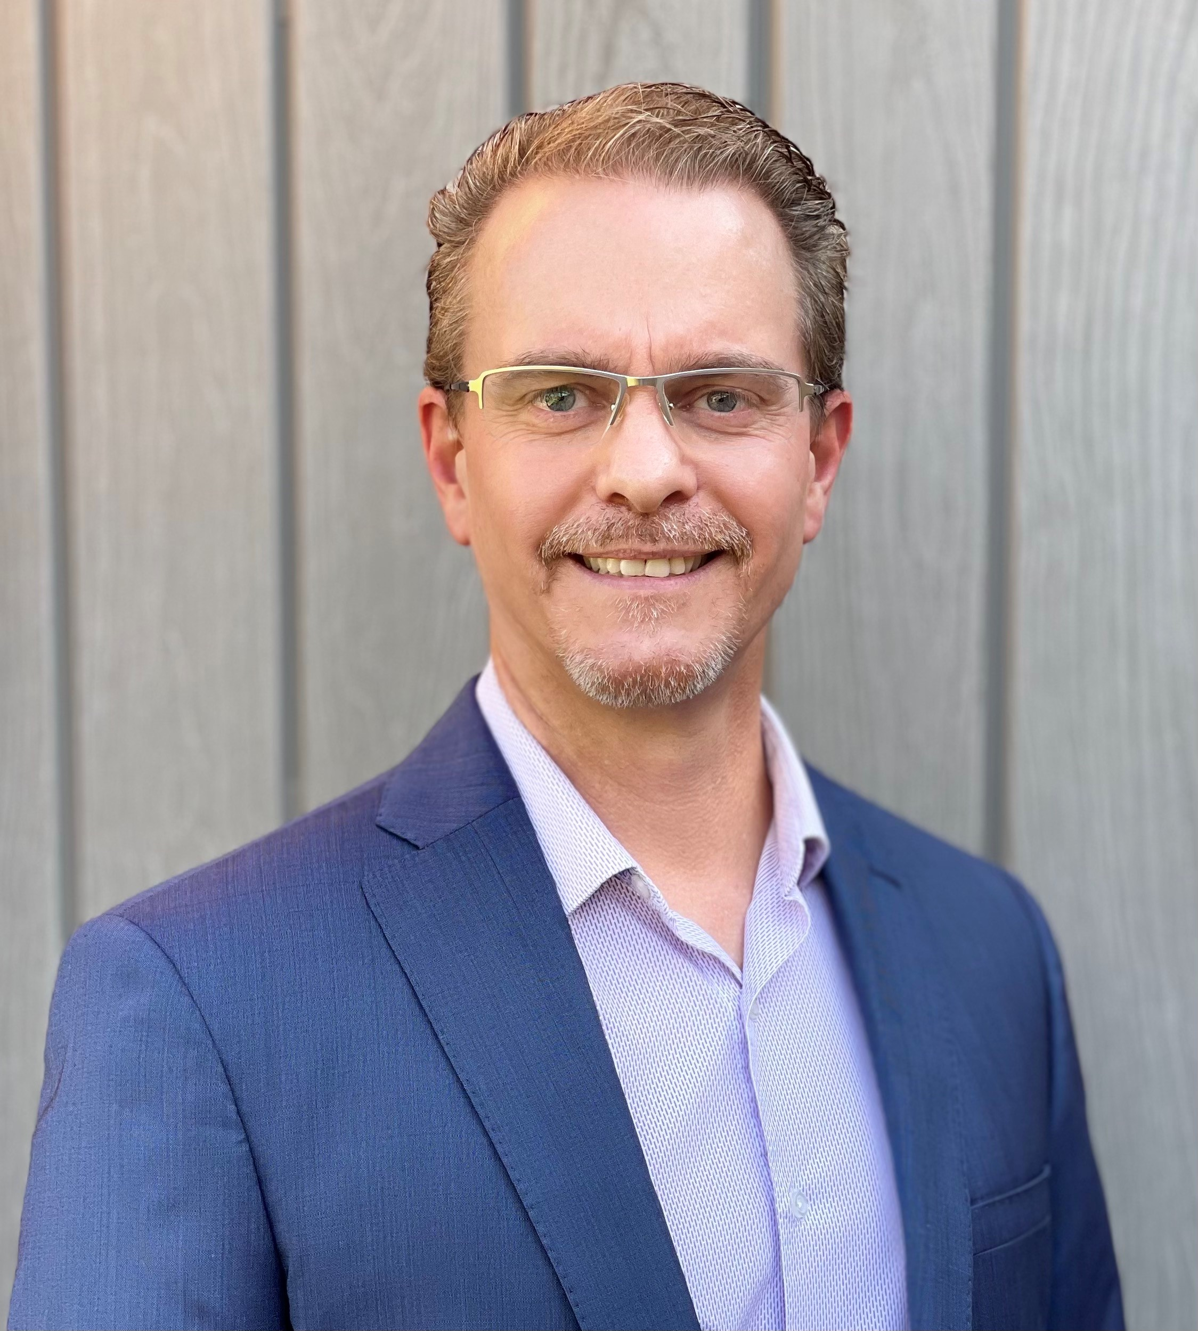
Craig Carter
IOT Product Line Manager
Intel Corporation
February 2022

Slide 3

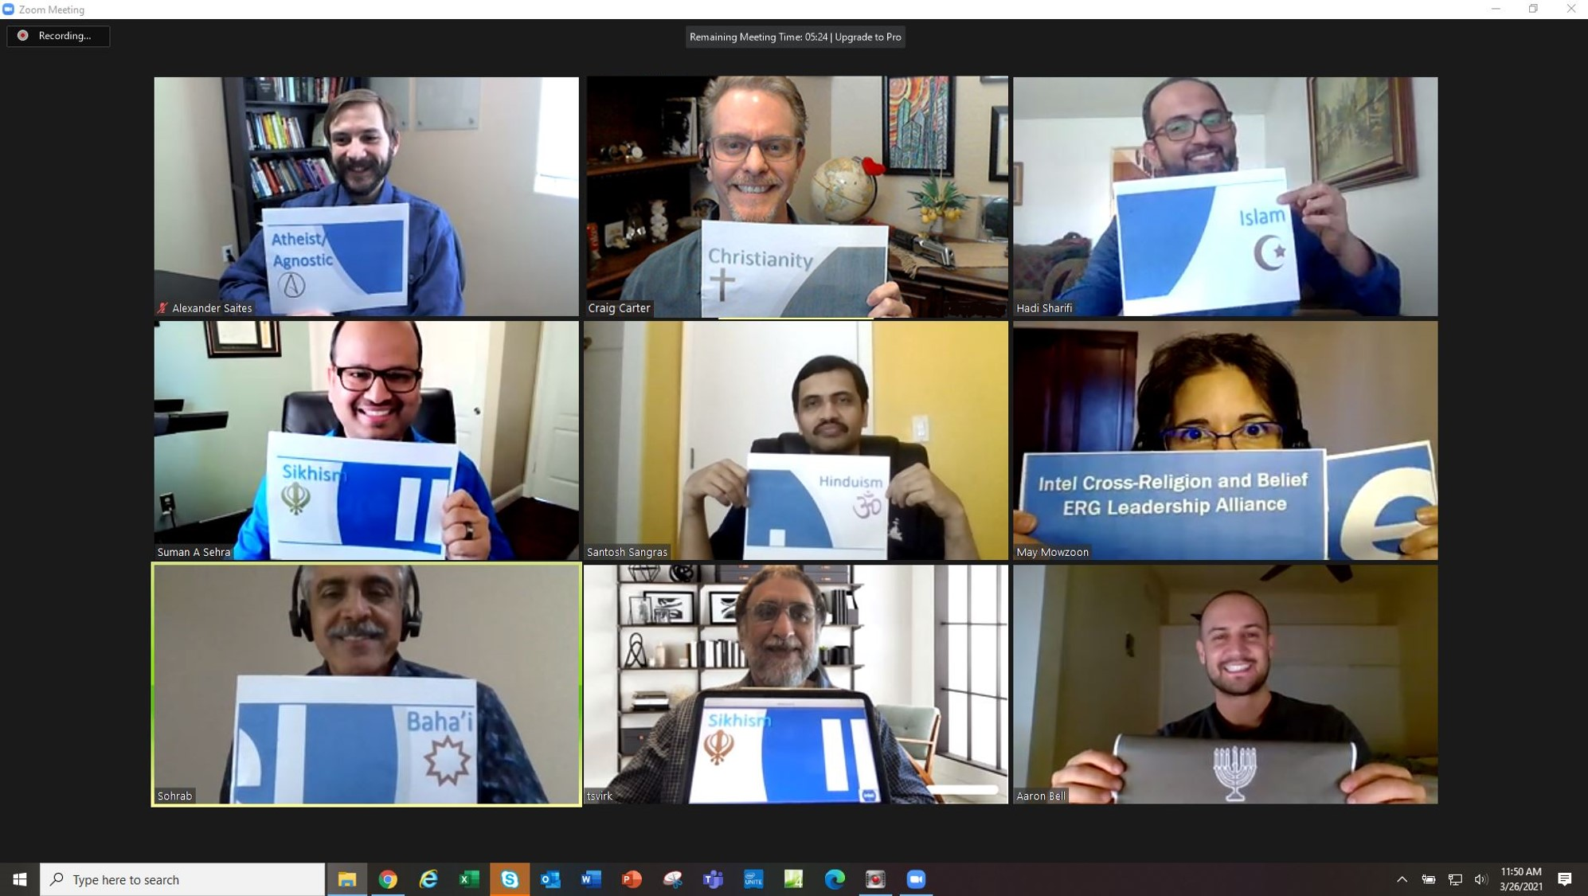
  Atheist/Agnostic
  Baha’i
  Christian
  Hindu
  Jewish
  Muslim
  Sikh
Atheist/Agnostic | Alexander Saites
Atheist/Agnostic | Julia Brown-Gratcheva
Atheist/Agnostic | Sarah Huntington
Baha'i | May Mowzoon
Christian | Craig Carter
Christian | Theo Martinescu
Hindu | Santosh Sangras
Jewish | Aaron Bell
Jewish | Magid Latif
Muslim | Hadi Sharifi
Muslim | Irfan Hasan
Muslim | Mohammed Shahid
Sikh | Tasvir Virk "Taz"
Sikh | Suman A Sehra
    Inviting Authenticity @ Work!

Slide 4

  January 2020
    Forcing an employee to wear a mask at work to cover their Faith…
    Does this invite authenticity?

Slide 5

Does life have a purpose?
Does anyone care for me?
Life is hard...
...but I have hope!
    Why does Faith matter to Employees?

Slide 6
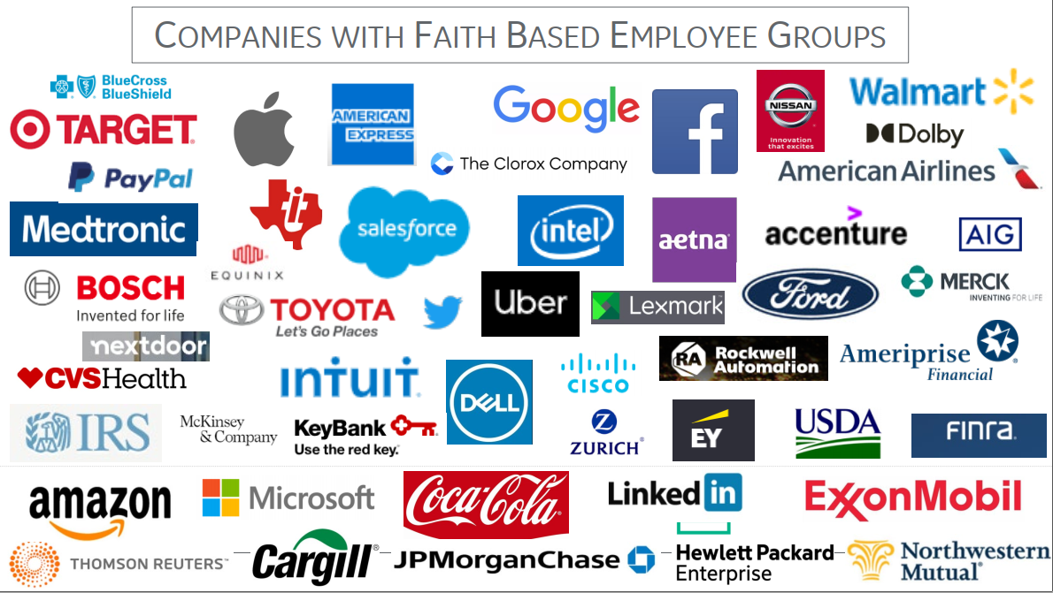
20% of Companies have Faith/Belief ERGs

Slide 7
There is a gap
20% of Companies
have Faith/Belief ERGs
85% Religious/Belief Affiliation (USA)
We
Have an
Opportunity...

Slide 8
  Atheist/Agnostic + Baha’i + Christian + Hindu + Jewish + Muslim + Sikh
  Excitement!!!
  Same Beliefs?
  Relationships &
  Commonality

Slide 9
  Why not?
    Different: We don’t do it today...
    Fear: pushy/awkward discussions
    Not Leader’s Identity or Journey

Slide 10
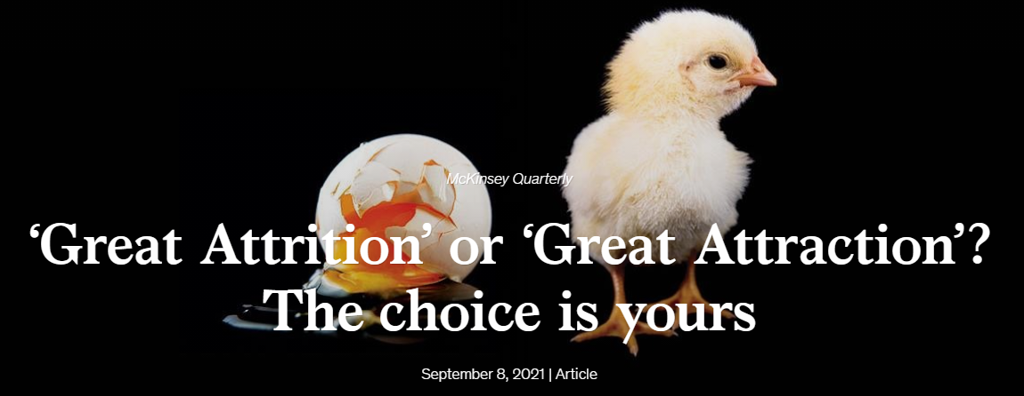
  Value
    Recruiting
    Retention
    “The top two reasons employees leave their jobs is lack of feeling valued...
    and a sense of belonging.”
    McKinsey & Company (Sept 2021)
    Results

Slide 11

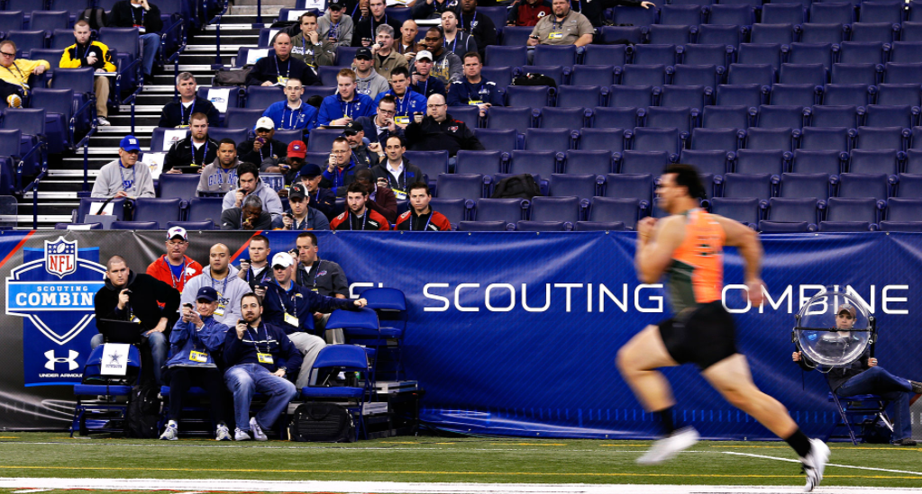


  Value
    Recruiting
    Retention
    Results

Slide 12
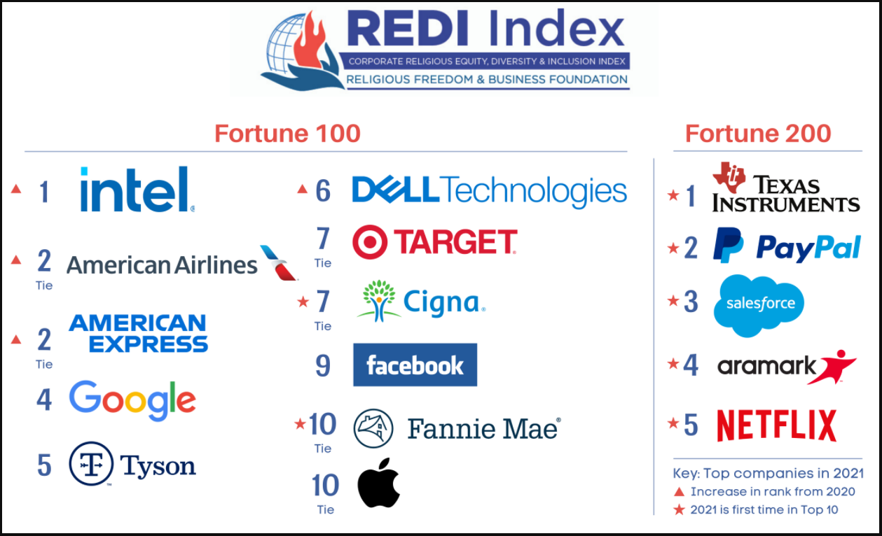
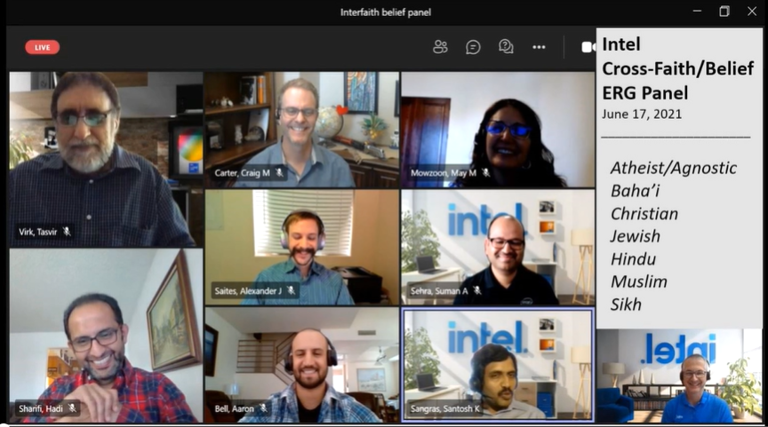

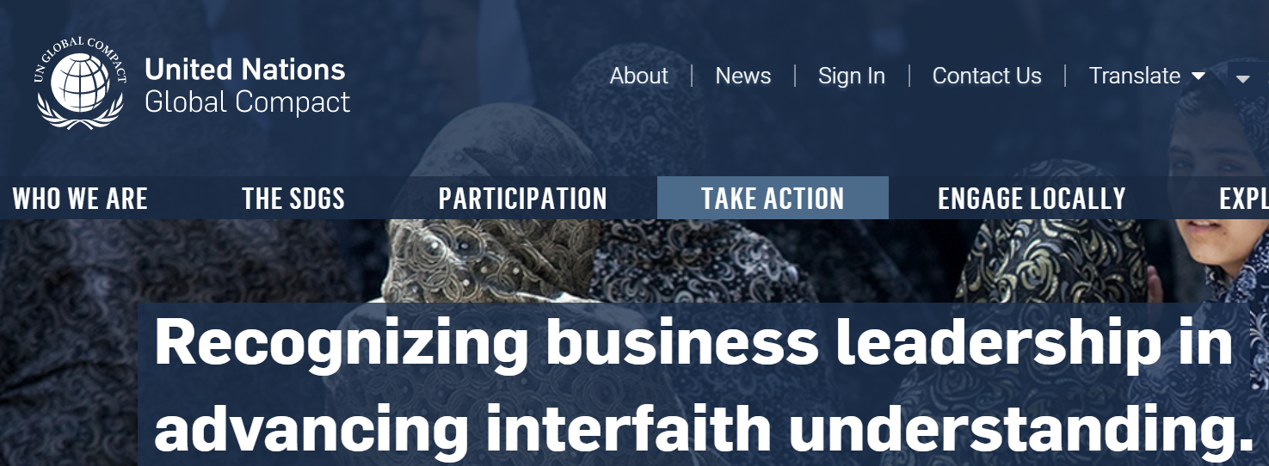
  Intel Panels &
  Awards
What is INSIDE matters

Slide 13
    Inviting Authenticity @ Work
    Faith/Belief ERGs help...
    Recruiting
    Retention
    Results
  Atheist/Agnostic + Baha’i + Christian + Hindu + Jewish + Muslim + Sikh
    Craig Carter Intel
    (on LinkedIn)

Slide 14
THANK YOU

Slide 15

Results: Require cultivating Good Soil/Environment
    The top two reasons employees leave their jobs is;
    lack of feeling valued and a sense of belonging.
    Intel HR, McKinsey & Company
How important is Faith/Belief to employees?
Notes:
Slide used internally in 2021 – when 15 Intel VPs agreed this is something we should pursue.

Slide 16

Cultivating an Attractive Environment = Better Business!
Faith & Belief Affiliation
(Pew Research)
Authentic Culture drives Results:
(Harvard Business Review)
USA 84%
Globally Growing
Authentic Vulnerable Leadership
Creates...
87%
50%
Higher
Performance
76%
Higher
Engagement
83%
106%
More
Energy
74%
Less
Stress
29%
Higher Life
Satisfaction
Learning Pyramid
Adoption through:
Leading/Teaching
(National Training Laboratories)
90% Leading or Teaching
20% Audio/Visual
75% Practicing
50% Discussion Group
10% Reading
30% Demonstration
5% Lecture
Notes:
Slide used internally in 2021 – when 15 Intel VPs agreed this is something we should pursue.

