Slide 1

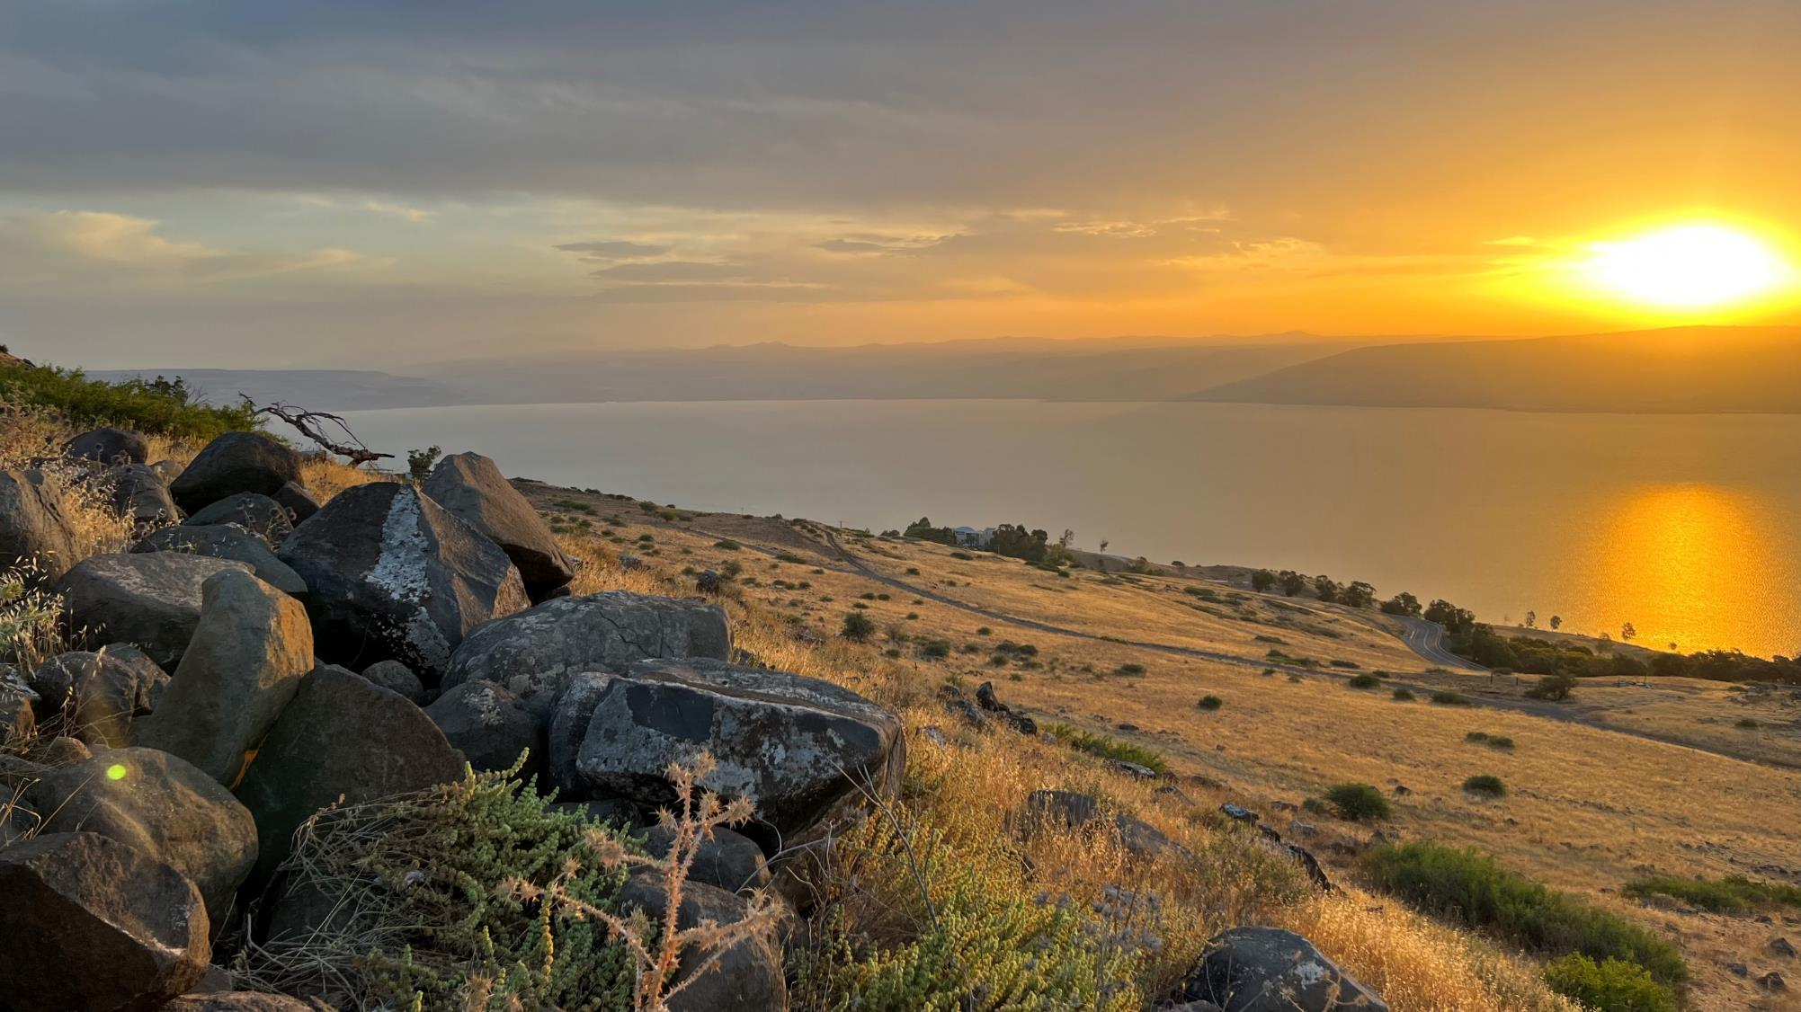
Welcome to: MARKETPLACE PRAYER!
All prayer is focused on the marketplace, people at work
No politics
Avoid putting down different parts of Christian traditions
No thinking small… ☺
Our God is a BIG God desiring to change the world with His LOVE!
AGENDA:
Bible Verse/Praise – Open (3-5min)
Listen to God – Quiet Time (3-5min)
Pray for Marketplace – Open (~15min)
COURAGE = Action in spite of fear
THIRD = Third place in a competition. God first, Others second, I am THIRD
Sea of Galilee at Sunrise - June 8, 2023

Slide 2
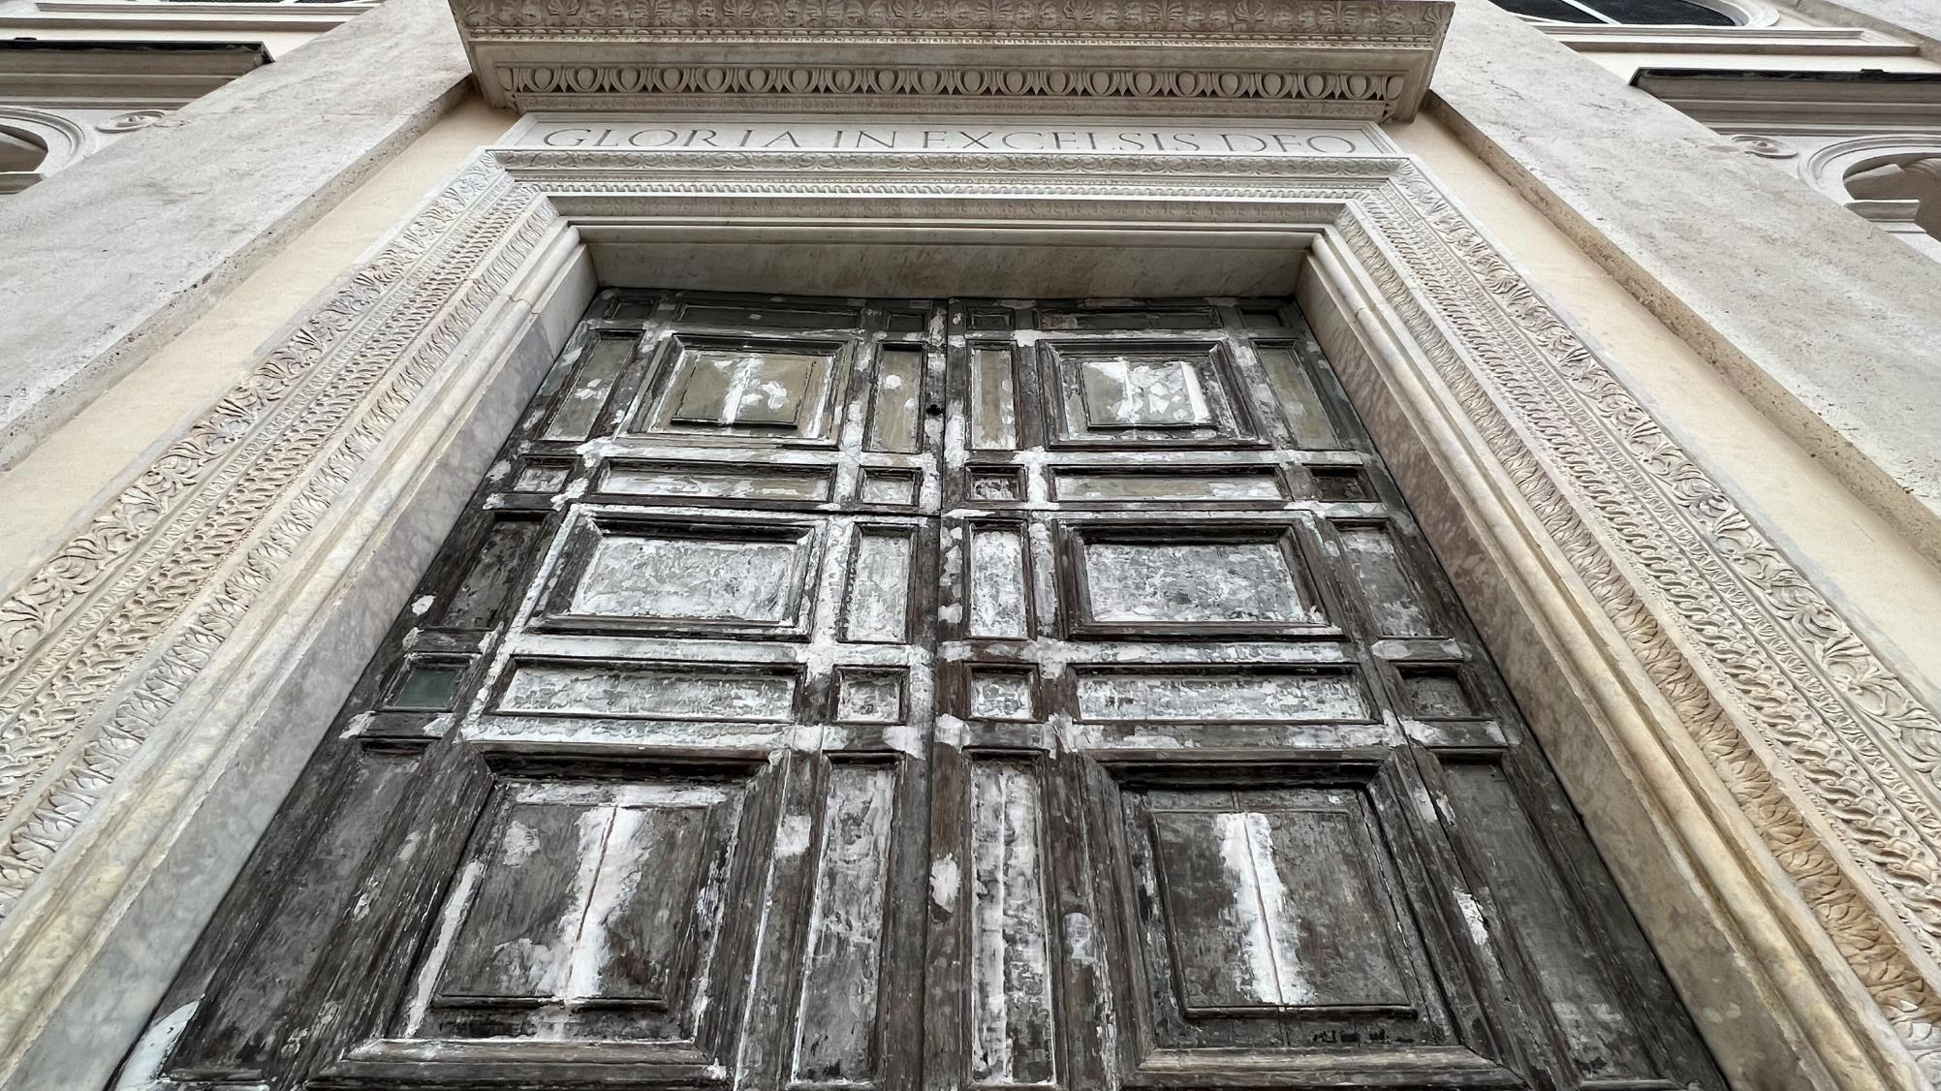
Very truly I tell you, whoever believes in me will do the works I have been doing,
and they will do even greater things than these, because I am going to the Father.
And I will do whatever you ask in my name, so that the Father may be glorified in the Son.
You may ask me for anything in my name, and I will do it.
John 14:12-14
Door in Rome Italy – February 2023

Slide 3
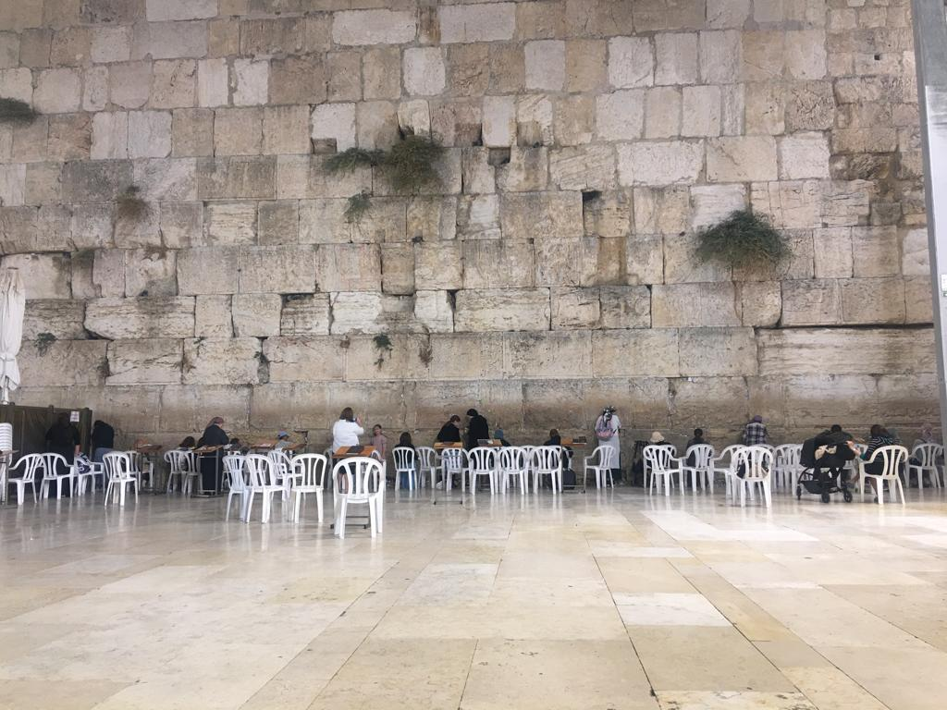
Your righteousness, God, reaches to the heavens,
you who have done great things.
Who is like you, God?
Though you have made me see troubles,
many and bitter, you will restore my life again;
from the depths of the earth you will again bring me up.
You will increase my honor and comfort me once more.
I will praise you with the harp for your faithfulness, my God;
I will sing praise to you with the lyre, Holy One of Israel.
Psalm 71: 19-22
Specific Israel related prayer requests:
Albert’s son – Israeli paratrooper deployed to fight in Gaza with not sufficient body armor
Christy – death threats, needs to flee Bethlehem Tuesday (Safe! in Jerusalem Oct 10, Jordon Oct 11, UK Oct 13)
Matthias – Superintendent of Bethlehem Lutheran School, for safety as he is there (Safe! Oct 14 in Germany with 20 teachers)
Florence/David – tourists trapped in Jerusalem, may God use them while there (Safe! Evacuated on Oct 13!)
Abed – Intel employee in Haifa, preparing for war, stocking up. Peace.
John – Believers in Jerusalem united and filled with Holy Spirit (Jerusalem Prayer Tower leader)
Western Wall of Prayer, Jerusalem – October 8, 2023

Slide 4
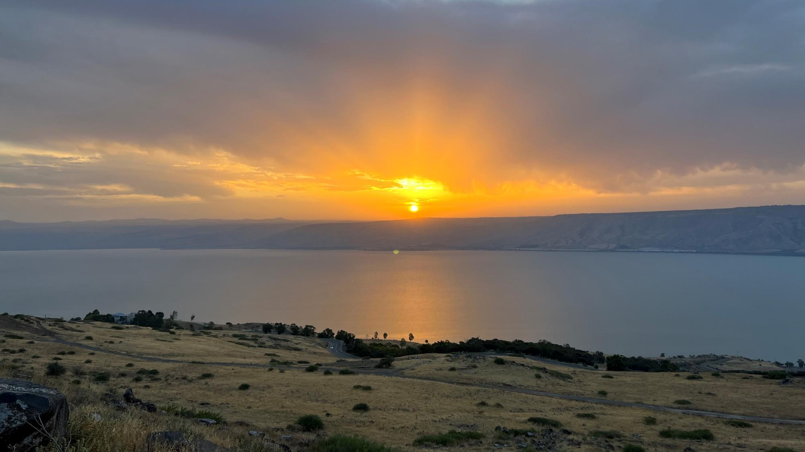
For in him all things were created:
things in heaven and on earth, visible and invisible, whether thrones or powers or rulers or authorities; all things have been created through him and for him.
Colossians 1:16
Sea of Galilee at Sunrise - June 8, 2023

Slide 5
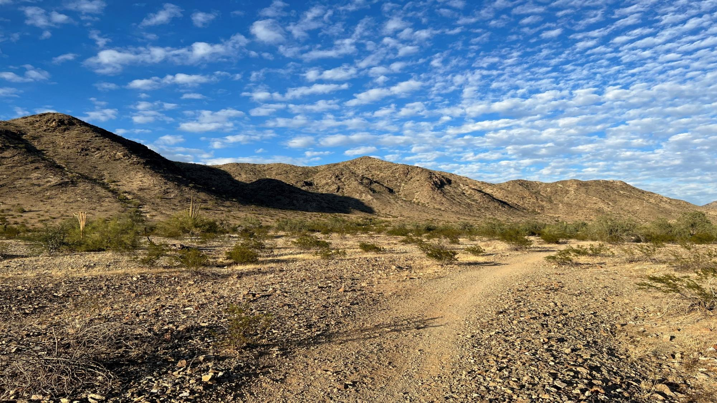
Devote yourselves to prayer, being watchful and thankful.
And pray for us, too, that God may open a door for our message, so that we may proclaim the mystery of Christ, for which I am in chains.
Pray that I may proclaim it clearly, as I should.
Colossians 4:2-4
Phoenix AZ, USA – 2023

Slide 6
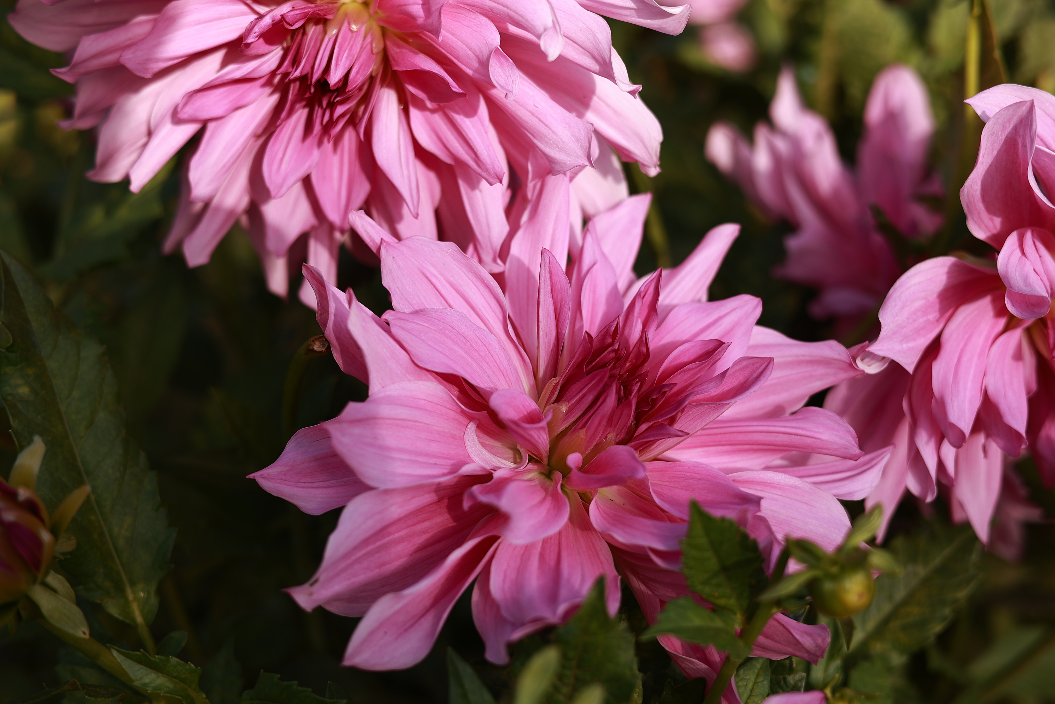
With this in mind, we constantly pray for you, that our God may count you worthy of His calling, and that by His power
He may fulfill every good purpose of yours and every act prompted by your faith. We pray this so that the name of our Lord Jesus may be glorified in you, and you in Him Thessalonians 1:11-12a
Lasi, Romania - October 2023

Slide 7
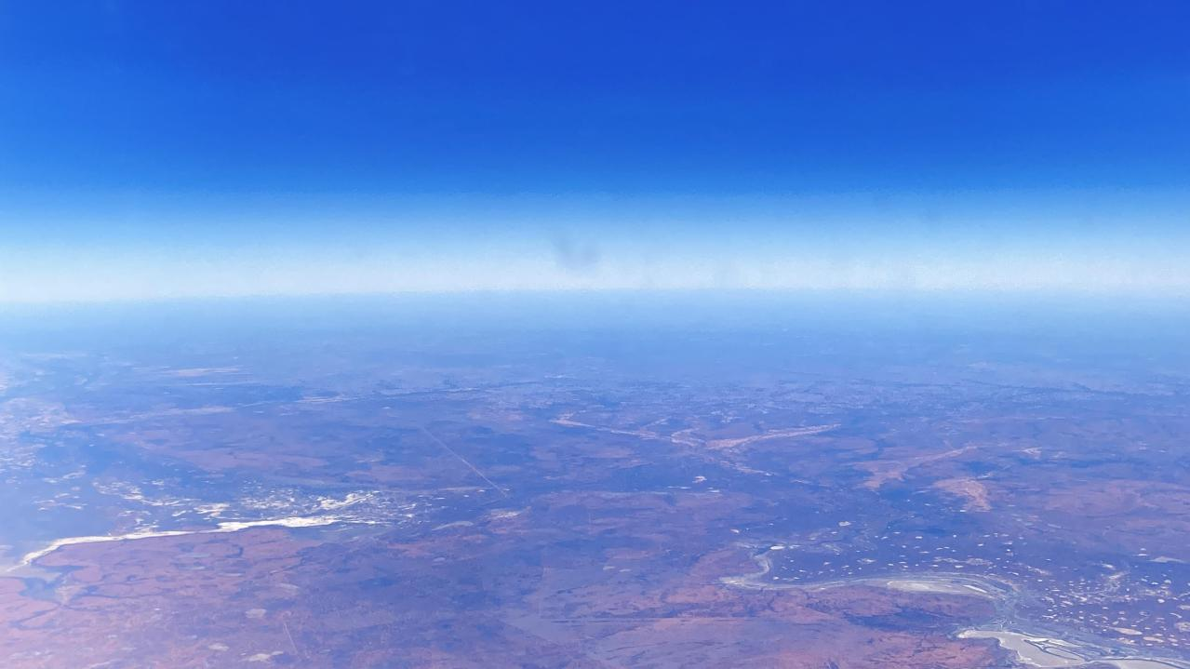
For the eyes of the Lord range throughout the earth
to strengthen those whose hearts are fully committed to him…
2 Chronicles 16:9
Somewhere over Australia – October 2023

Slide 8
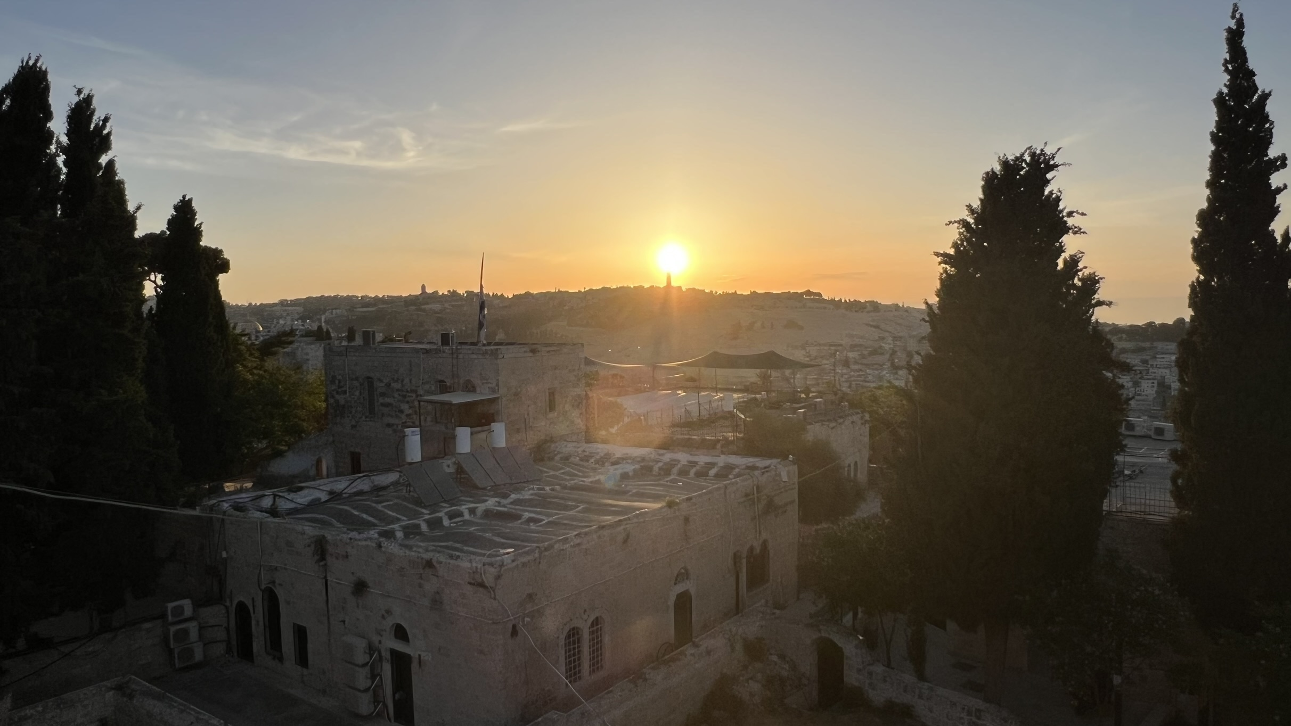
Do you not know? Have you not Heard?
The Lord is the everlasting God the Creator of the ends of the earth.
He will not grow tired or weary, and His understanding no one can fathom.
He gives strength to the weary and increases the power of the weak.
Even youth grow tired and weary and young men stumble and fall, but those who hope/wait on the Lord will renew their strength.
They will soar on the wings like eagles, they will run and not grow weary, they will walk and not be faint.
Isaiah 40:27-31
Jerusalem, looking east at sunrise over the Mount of Olives at spire of the “Church of the Ascension” - June 2023

Slide 9
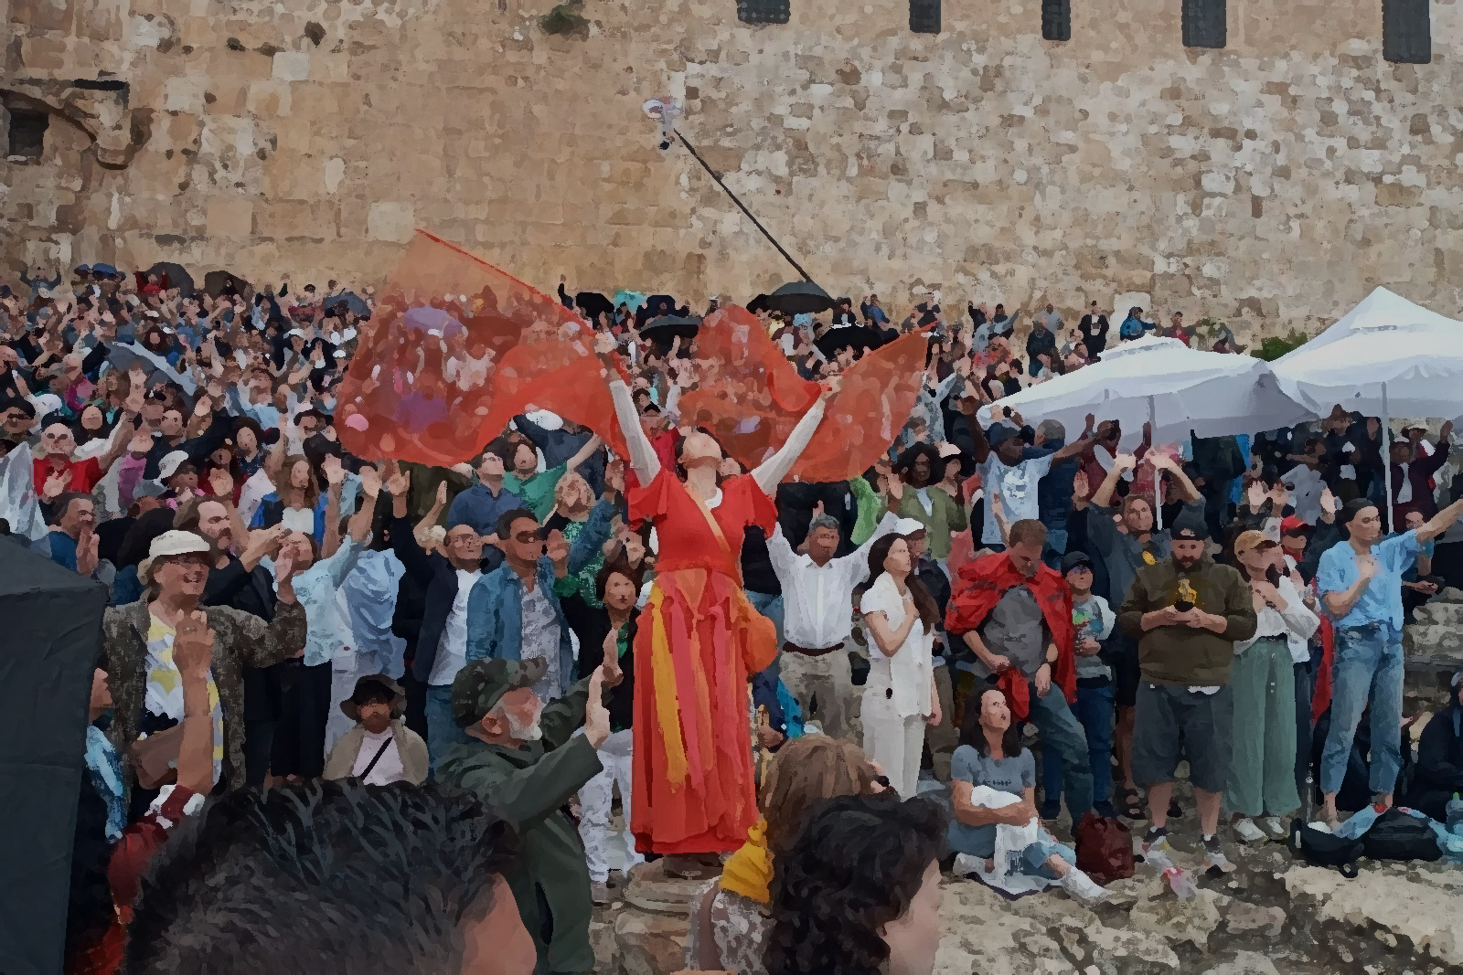
Devote yourselves to prayer, being watchful and thankful.
And pray for us, too, that God may open a door for our message, so that we may proclaim the mystery of Christ, for which I am in chains.
Pray that I may proclaim it clearly, as I should.
Colossians 4:2-4
Jerusalem, Southern Steps on Temple Mound – Pentecost Sunday May 28, 2023

Slide 10
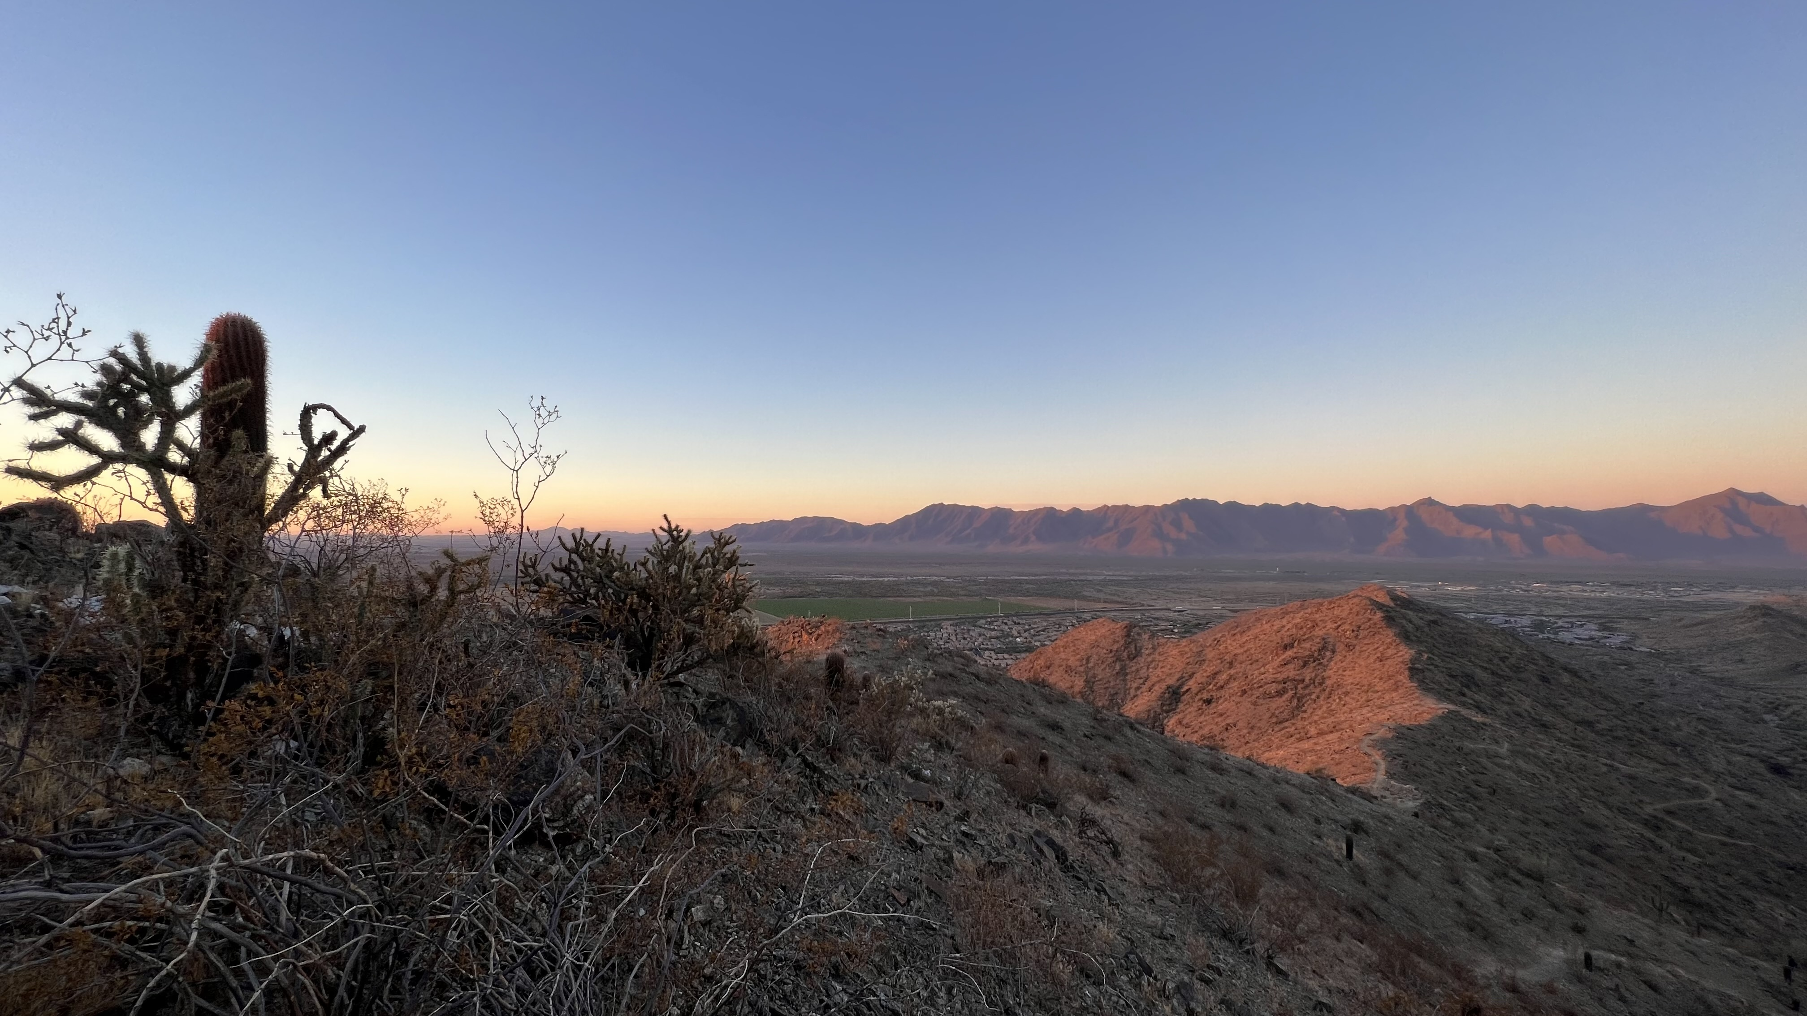
We proclaim Him, admonishing and teaching everyone with all wisdom,
so that we may present everyone perfect in Christ.
To this end I labor, struggling with all His energy which so powerfully works in me.
(Colossians 1:28-29)
South Mountain Park, Phoenix Arizona USA, November 24, 2023
Phoenix, AZ USA – August 2023

Slide 11
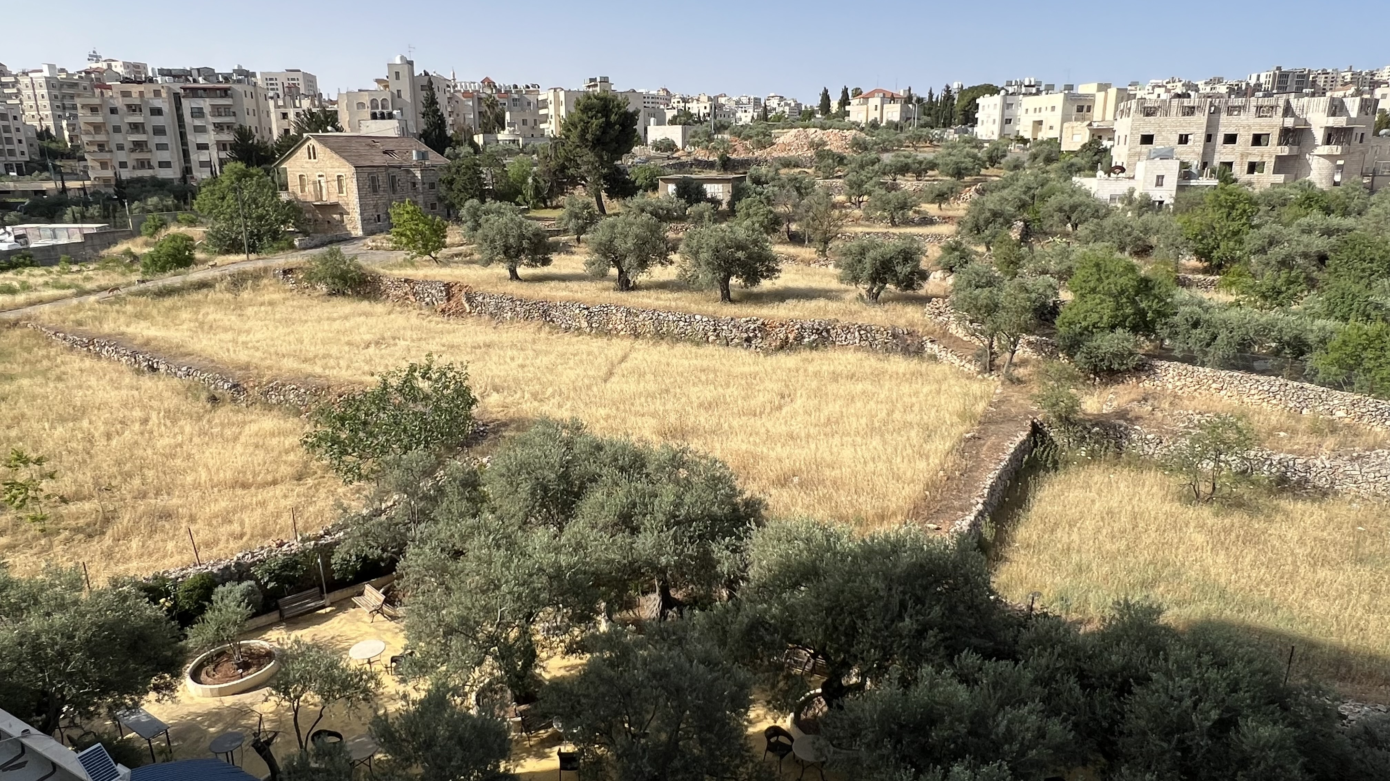
For unto us a child is born, to us a son is given, and the government will be on his shoulders and he will be called Wonderful Counselor, Mighty God, Everlasting Father, Prince of Peace.
(Isaiah 9:6)
Olive trees in Field, Bethlehem, Israel-Palestine May 25, 2023

Slide 12
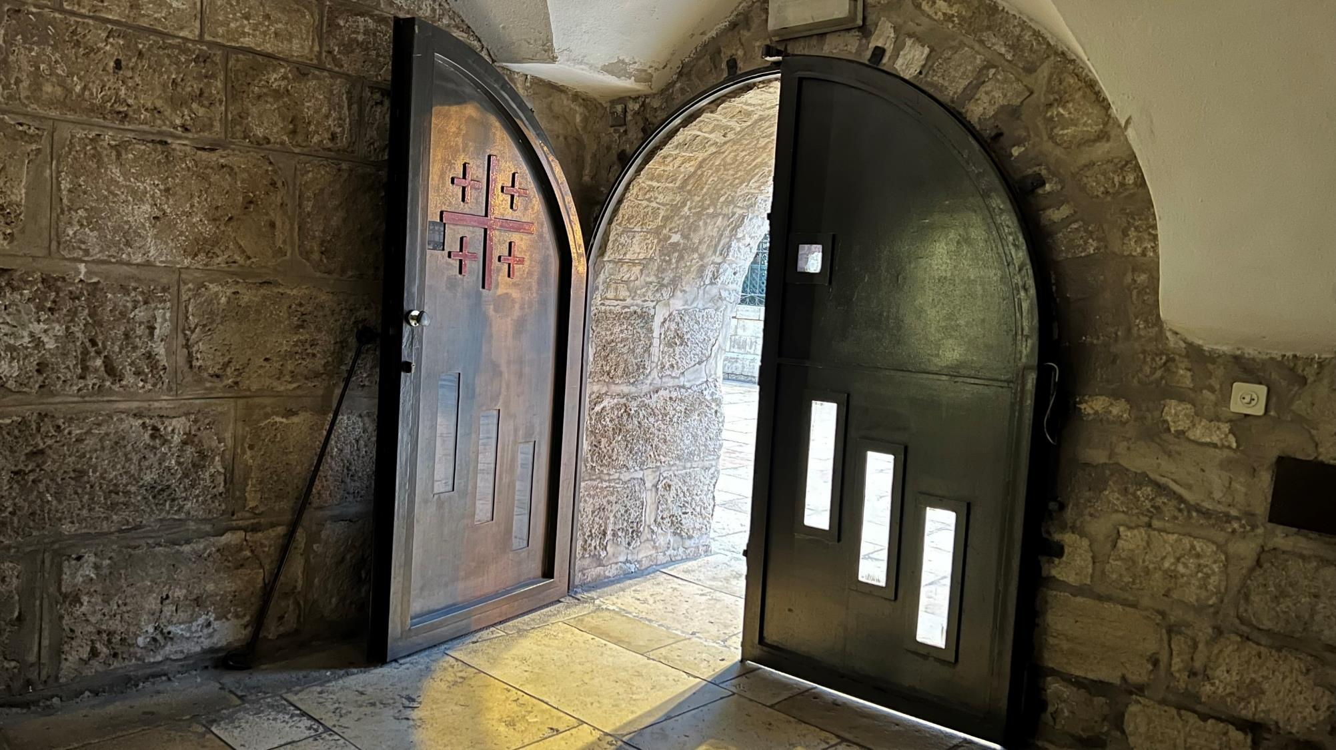
He said to them:
“It is not for you to know the times or dates the Father has set by his own authority.
But you will receive power when the Holy Spirit comes on you; and you will be my witnesses in Jerusalem, and in all Judea and Samaria, and to the ends of the earth.”
Acts 1:7-8
Church of the Nativity, Bethlehem, Israel – Pentecost Sunday May 28, 2023

Slide 13
Suddenly a great company of the heavenly host appeared with the angel, praising God and saying,
“Glory to God in the highest,
and on earth peace to those
on whom His favor rests”
Luke 2:13-14
Sea of Galilee at Sunrise - June 8, 2023

Slide 14
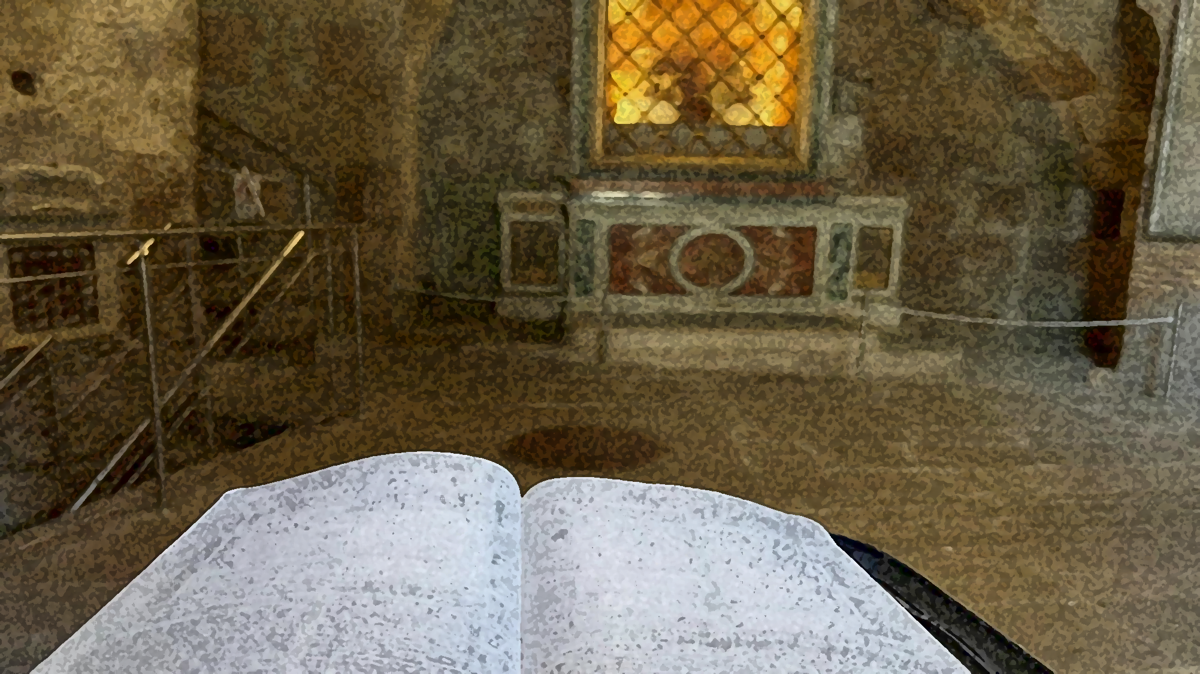
…for the sake of his body, which is the church. I have become its servant by the commission God gave me to present to you the word of God in its fullness— the mystery that has been kept hidden for ages and generations, but is now disclosed to the Lord’s people.
Colossians 1:24-26
Mamertine Prison, Rome Italy, (where Paul/Peter spent last days) - February 2, 2023

Slide 15
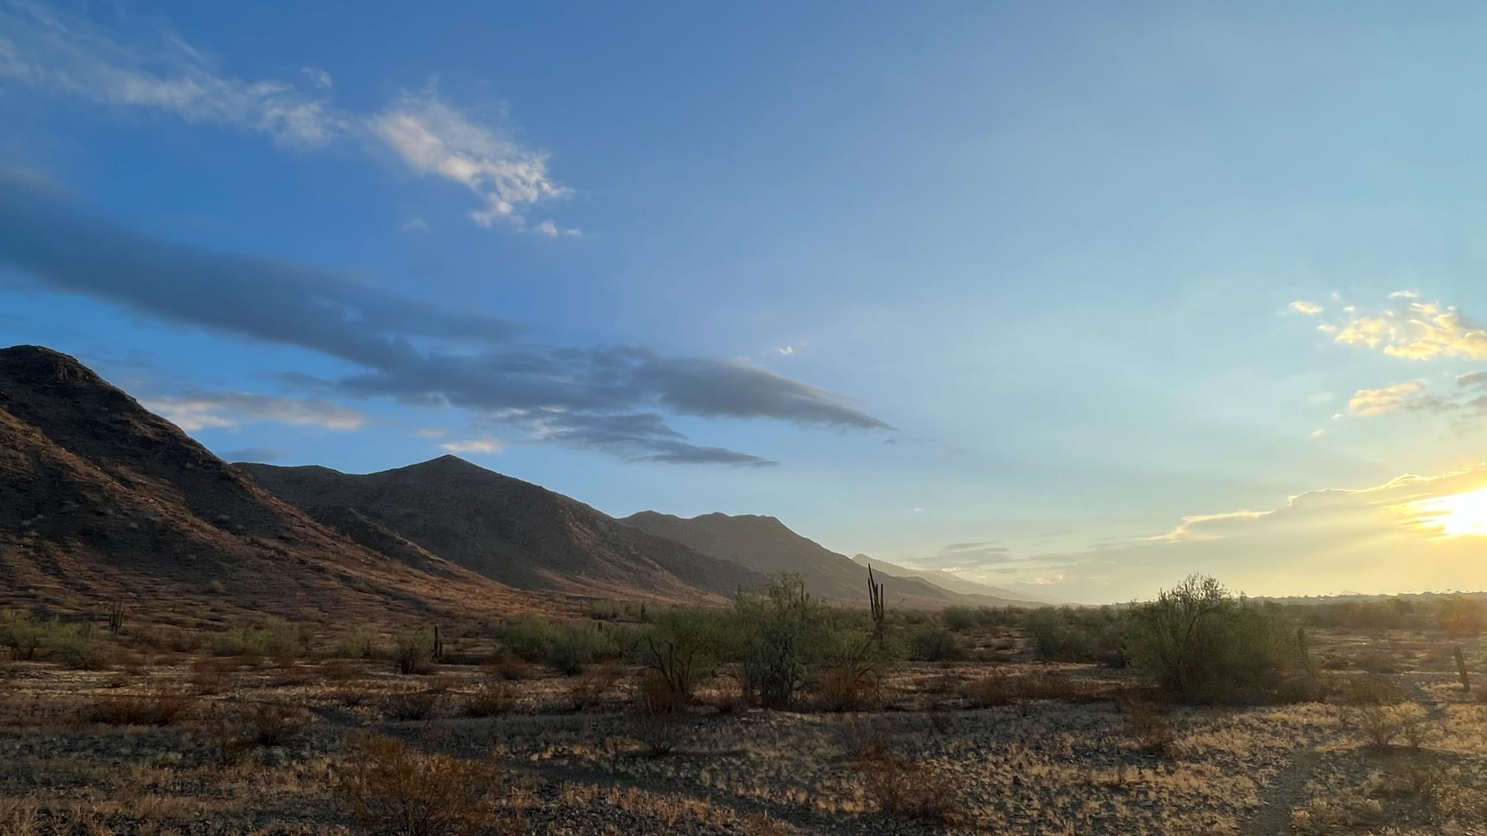
Your righteousness, God, reaches to the heavens,
you who have done great things.
Who is like you, God?
Though you have made me see troubles,
many and bitter, you will restore my life again;
from the depths of the earth you will again bring me up.
You will increase my honor and comfort me once more.
I will praise you with the harp for your faithfulness, my God;
I will sing praise to you with the lyre, Holy One of Israel.
Psalm 71: 19-22
Phoenix AZ, USA – September 2023

Slide 16
I want you to know how hard I am contending for you and for those at Laodicea, and for all who have not met me personally.
My goal is that they may be encouraged in heart and united in love, so that they may have the full riches of complete understanding, in order that they may know the mystery of God, namely, Christ, in whom are hidden all the treasures of wisdom and knowledge.
I tell you this so that no one may deceive you by fine-sounding arguments.
For though I am absent from you in body, I am present with you in spirit and delight to see how disciplined you are and how firm your faith in Christ is.
(Colossians 2:1-5)
Door in Rome Italy – February 2023

Slide 17

Do you not know? Have you not Heard?
The Lord is the everlasting God the Creator of the ends of the earth.
He will not grow tired or weary, and His understanding no one can fathom.
He gives strength to the weary and increases the power of the weak.
Even youth grow tired and weary and young men stumble and fall, but those who hope/wait on the Lord will renew their strength.
They will soar on the wings like eagles, they will run and not grow weary, they will walk and not be faint.
Isaiah 40:27-31
Lasi, Romania, October 2023

Slide 18
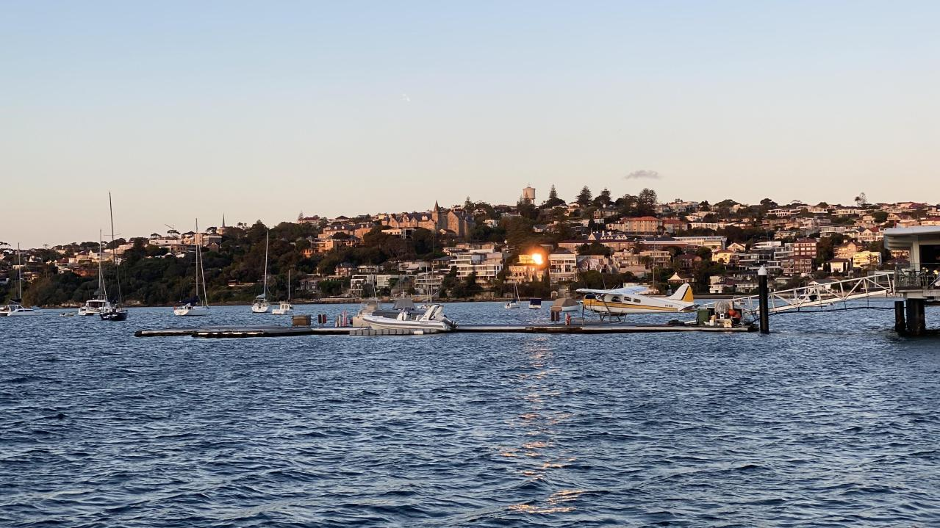
Then Jesus came to them and said,
All authority in heaven and on earth has been given to me. Therefore go and make disciples of all nations, baptizing them in the name of the Father and of the Son and of the Holy Spirit, and teaching them to obey everything I have commanded you. And surely I am with you always, to the very end of the age.
Matthew 28:18-20
My goal is that they may be encouraged in heart and united in love, so that they may have the full riches of complete understanding, in order that they may know the mystery of God, namely, Christ, in whom are hidden all the treasures of wisdom and knowledge.
Colossians 2:2-3
Sydney Harbor, Australia – October 2023

Slide 19
We do, however, speak a message of wisdom among the mature, but not the wisdom of this age or of the rulers of this age, who are coming to nothing.
No, we declare God’s wisdom, a mystery that has been hidden and that God destined for our glory before time began.
1 Corinthians 2:6-7
Sea of Galilee at Sunrise - June 8, 2023

Slide 20
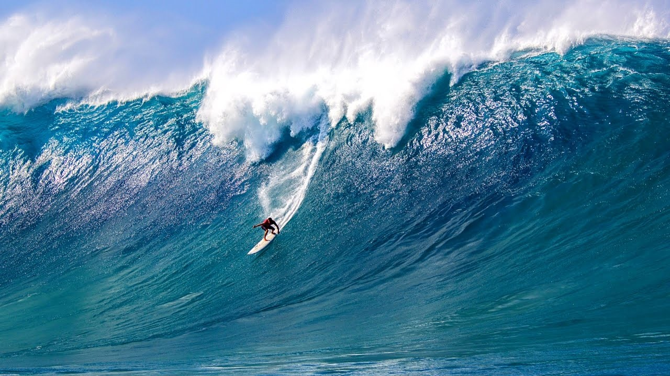
This Photo by Unknown Author is licensed under CC BY-NC

