Slide 1
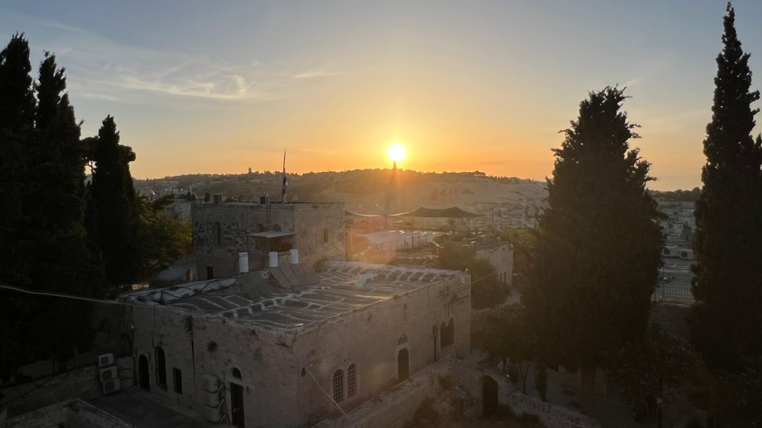

Welcome to Marketplace Prayer!
Our focus is on the marketplace and people at work
PLEASE…
No politics
Respect differences in Christian beliefs/traditions
Pray bold, audacious prayers! Our God is BIG and He desires to change the world with His LOVE!
AGENDA:
Worship Music (3-5 min)
Bible Verse/Praise (3-5 min)
Listen to God/Quiet Time (1-2 min)
Pray for Marketplace (~15min)
COURAGEOUS
Action in spite of fear
THIRD
God first, Others second, I am third
Jerusalem, sunrise over the Mount of Olives at spire of the “Church of the Ascension” June 2023

Slide 2
Q4 Prayer Schedule
Due to various holidays in the U.S. during Q4, below are the days all prayer meetings will be canceled:
Monday, Nov. 11 (Veterans Day)
Nov. 25 – 29 (Thanksgiving week)
December 23 – Jan. 10 (Christmas and New Years break)
Q1 Prayer Meetings will resume starting January 13th.

Slide 3

Ephesians 5:1-2
Follow God’s example, therefore, as dearly loved children and walk in the way of love, just as Christ loved us and gave himself up for us as a fragrant offering and sacrifice to God.
Week of September 30

Slide 4
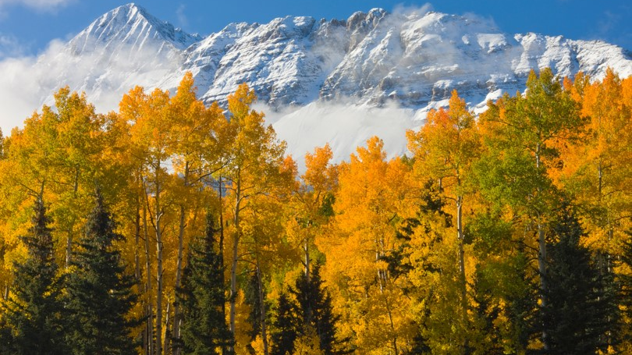
2 Thessalonians 3:16
Now may the Lord of peace himself give you peace at all times and in every way.
The Lord be with all of you.
Week of October 7

Slide 5

Romans 15:13
May the God of hope fill you with all joy and peace as you trust in him, so that you may overflow with hope by the power of the Holy Spirit.
Week of October 14

Slide 6
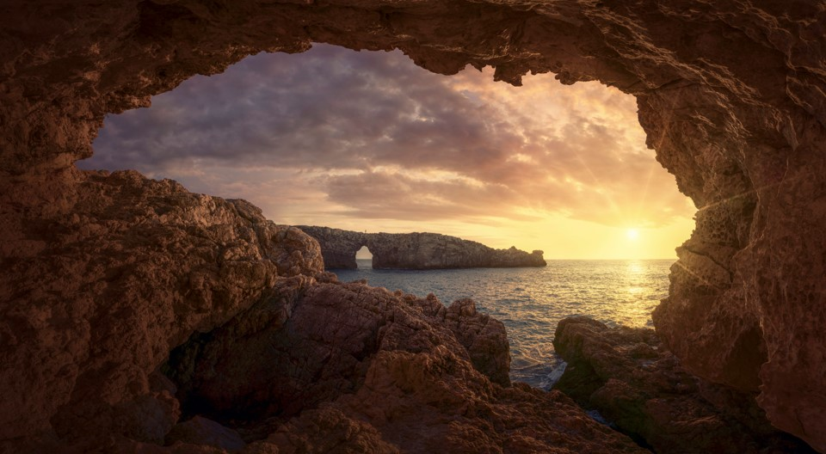
Psalm 51:10
Create in me a pure heart, O God, and renew a steadfast spirit within me.
Week of October 21

Slide 7

Isaiah 26:2-4
Open the gates that the righteous nation may enter, the nation that keeps faith. You will keep in perfect peace those whose minds are steadfast, because they trust in you. Trust in the Lord forever, for the Lord, the Lord himself, is the Rock eternal.
Week of October 28

Slide 8
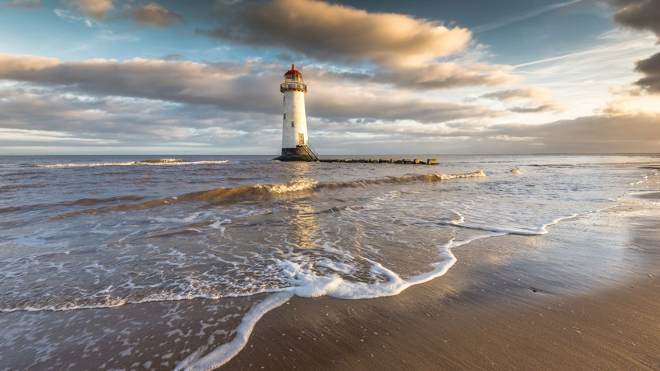
Matthew 11:28-30
“Come to me, all you who are weary and burdened, and I will give you rest. Take my yoke upon you and learn from me, for I am gentle and humble in heart, and you will find rest for your souls. For my yoke is easy and my burden is light.”
Week of November 4

Slide 9
No Prayer Meetings on Monday November 11
In observance of the U.S. Veteran’s Day holiday.
All other prayer meetings will meet as scheduled.
Scripture on the next slide.

Slide 10

1 Corinthians 16:13-14
Be on your guard; stand firm in the faith; be courageous; be strong. Do everything in love.
Week of November 11

Slide 11

Psalm 69:30
I will praise God’s name in song and glorify him with thanksgiving.
Week of November 18

Slide 12
No Prayer Meetings November 25-29
In observance of the U.S. Thanksgiving Day holiday, there will be no prayer meetings the week of November 25th.

Slide 13
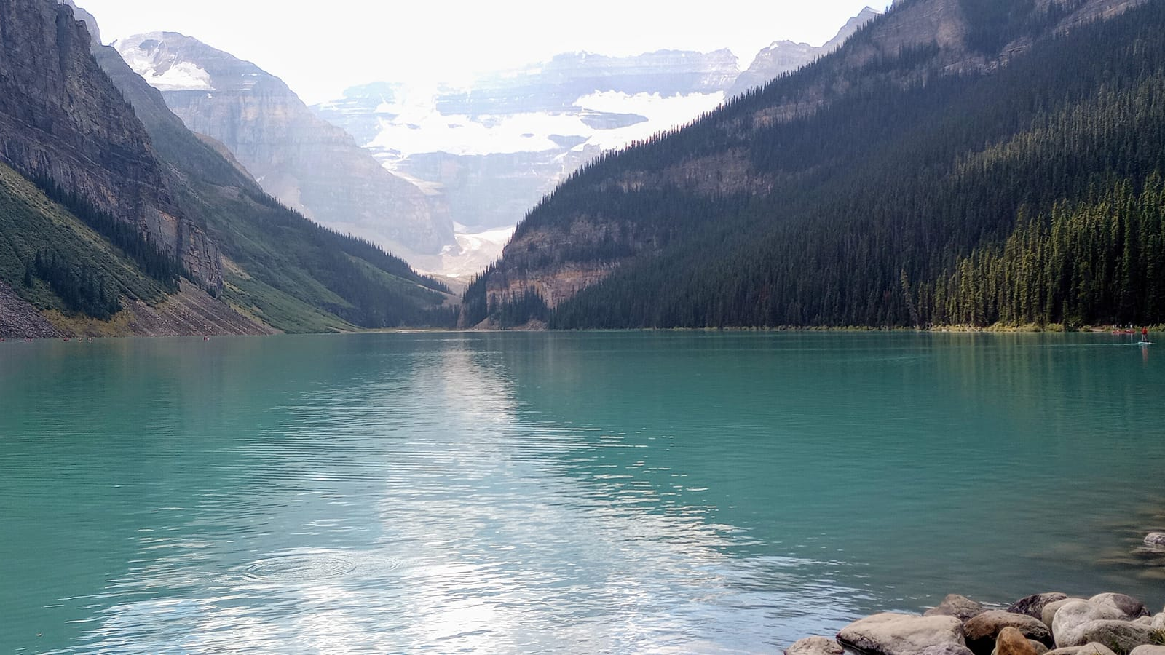
Psalm 139:23-24
Search me, God, and know my heart; test me and know my anxious thoughts. See if there is any offensive way in me, and lead me in the way everlasting.
Week of December 2

Slide 14
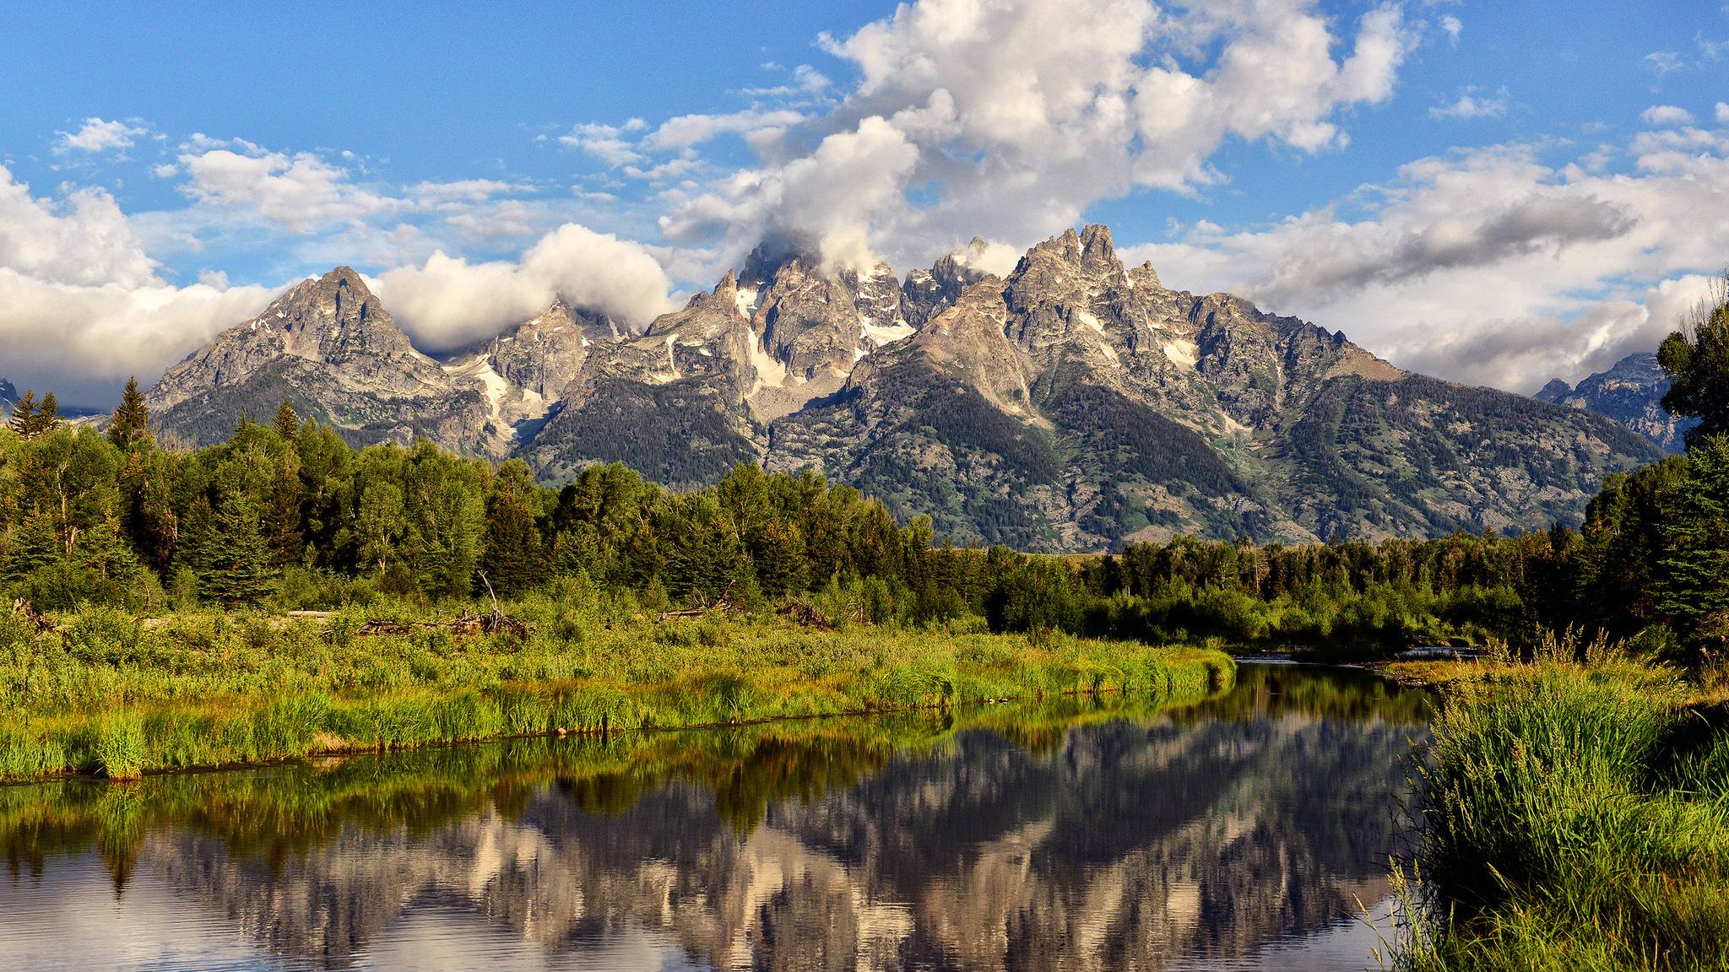
Isaiah 11:2-3a
The Spirit of the Lord will rest on him— the Spirit of wisdom and of understanding, the Spirit of counsel and of might, the Spirit of the knowledge and fear of the Lord— and he will delight in the fear of the Lord.
Week of December 9

Slide 15

Luke 2:10-11
But the angel said to them, “Do not be afraid. I bring you good news that will cause great joy for all the people. Today in the town of David a Savior has been born to you; he is the Messiah, the Lord.
Week of December 16

Slide 16

No Prayer Meetings Dec. 23 – Jan. 10
Prayer Meetings will be on hiatus from December 23 – Jan. 10 for the Christmas and New Years break.
Q1 Prayer Meetings will resume starting January 13th.
Registration for 2025 Prayer Meetings will be available January 8th. Check our website or watch your email for more details!
www.courageousthird.org

