Slide 1
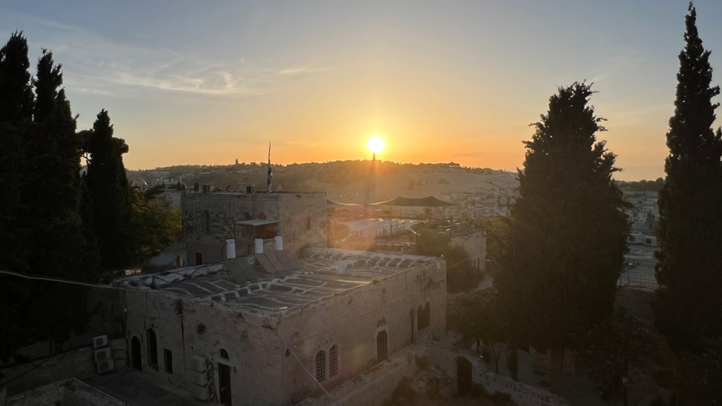

Welcome to Marketplace Prayer!
Our focus is on the marketplace and people at work
PLEASE…
No politics
Respect differences in Christian beliefs/traditions
Pray bold, audacious prayers! Our God is BIG and He desires to change the world with His LOVE!
AGENDA:
Worship Music (3-5 min)
Bible Verse/Praise (3-5 min)
Listen to God/Quiet Time (1-2 min)
Pray for Marketplace (~15min)
COURAGEOUS
Action in spite of fear
THIRD
God first, Others second, I am third
Jerusalem, sunrise over the Mount of Olives at spire of the “Church of the Ascension” June 2023

Slide 2
No Prayer Meetings the Week of July 1
In observance of the U.S. Fourth of July holiday.
Q3 Prayer Meetings begin Monday, July 8th.

Slide 3

Psalm 16:11
You make known to me the path of life; you will fill me with joy in your presence, with eternal pleasures at your right hand.
Week of July 8
Notes:
July 8

Slide 4

Colossians 3:23-24
Whatever you do, work at it with all your heart, as working for the Lord, not for human masters, since you know that you will receive an inheritance from the Lord as a reward. It is the Lord Christ you are serving.
Week of July 15
Notes:
July 15

Slide 5

Matthew 5: 43-45
You have heard that it was said, ‘Love your neighbor and hate your enemy. ’But I tell you, love your enemies and pray for those who persecute you, that you may be children of your Father in heaven. He causes his sun to rise on the evil and the good, and sends rain on the righteous and the unrighteous.
Week of July 22
Notes:
July 22

Slide 6
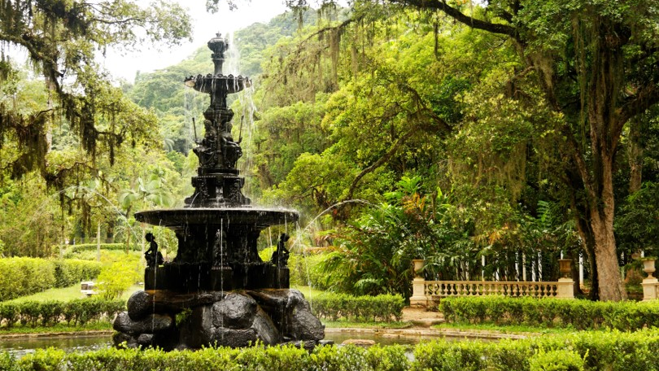
Psalm 86:11
Teach me your way, Lord, that I may rely on your faithfulness; give me an undivided heart, that I may fear your name.
Week of July 29
Notes:
July 29

Slide 7
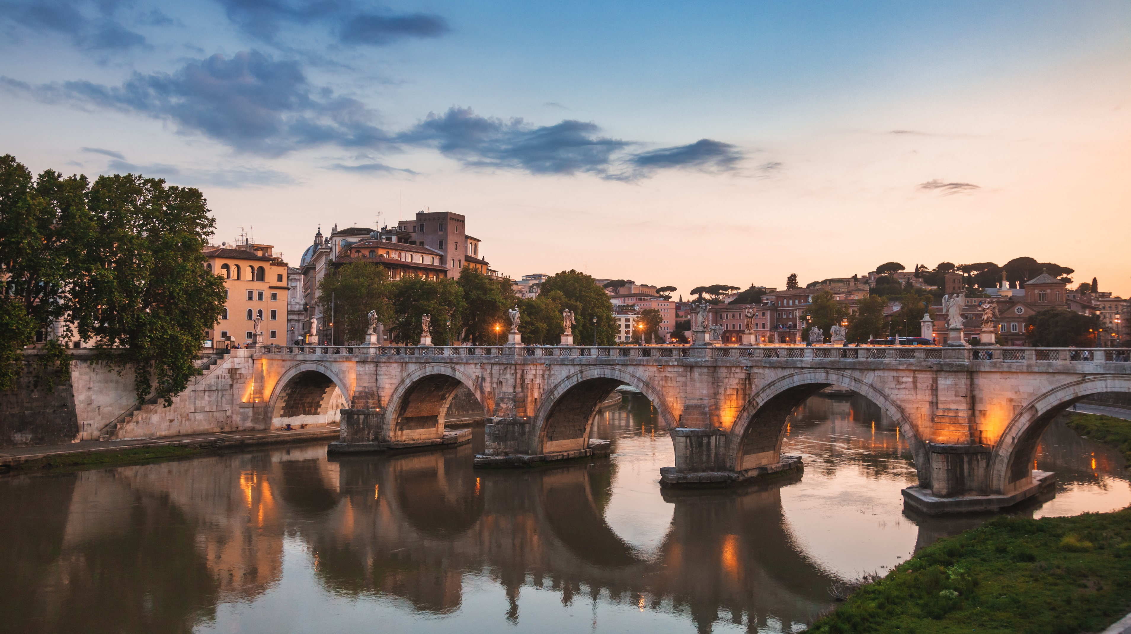
Romans 12:9-10
Love must be sincere. Hate what is evil; cling to what is good. Be devoted to one another in love. Honor one another above yourselves.
Week of August 5
Notes:
Aug. 5

Slide 8

1 Thessalonians 5:16-18
Rejoice always, pray continually, give thanks in all circumstances; for this is God’s will for you in Christ Jesus.
Week of August 12
Notes:
Aug. 12

Slide 9

Deuteronomy 31:8
The Lord himself goes before you and will be with you; he will never leave you nor forsake you. Do not be afraid; do not be discouraged.
Week of August 19
Notes:
Aug. 19

Slide 10
Luke 6:27-28
But to you who are listening I say: Love your enemies, do good to those who hate you, bless those who curse you, pray for those who mistreat you.
Week of August 26
Notes:
Aug. 26

Slide 11
No Prayer Meetings on Monday September 2
In observance of the U.S. Labor Day holiday.
The Wednesday and Friday prayer meetings will meet as scheduled that week. Scripture on the next slide.

Slide 12

Psalm 143:8
Let the morning bring me word of your unfailing love, for I have put my trust in you. Show me the way I should go, for to you I entrust my life.
Week of September 2
Notes:
Sept. 2

Slide 13

Romans 15:5-6
May the God who gives endurance and encouragement give you the same attitude of mind toward each other that Christ Jesus had, so that with one mind and one voice you may glorify the God and Father of our Lord Jesus Christ.
Week of September 9
Notes:
Sept. 9

Slide 14

Mark 12: 30-31
Love the Lord your God with all your heart and with all your soul and with all your mind and with all your strength.’ The second is this: ‘Love your neighbor as yourself.’ There is no commandment greater than these.”
Week of September 16
Notes:
Sept. 16

Slide 15

Isaiah 25:1
Lord, you are my God; I will exalt you and praise your name, for in perfect faithfulness you have done wonderful things, things planned long ago.
Week of September 23
Notes:
Sept. 23

