Slide 1

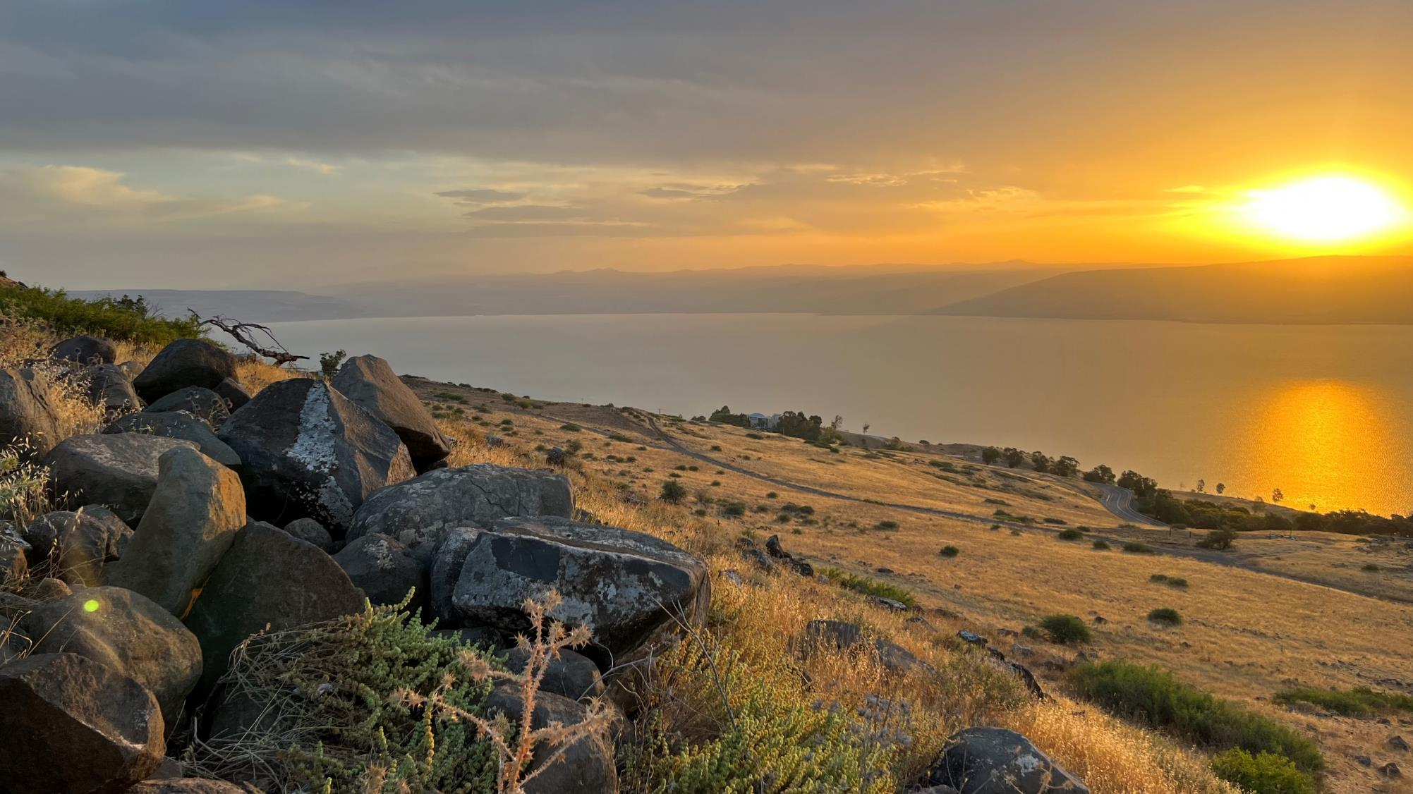
Welcome to: MARKETPLACE PRAYER!
Our focus is on the marketplace, people at work
No politics
Respect differences in Christian beliefs/traditions
Pray bold, audacious prayers! Our God is BIG and He desires to change the world with His LOVE!
AGENDA:
Bible Verse/Praise – Open (3-5min)
Listen to God – Quiet Time (3-5min)
Pray for Marketplace – Open (~15min)
COURAGE = Action in spite of fear.
THIRD = Third place. God first, Others second, I am THIRD.
Sea of Galilee at Sunrise, Israel

Slide 2
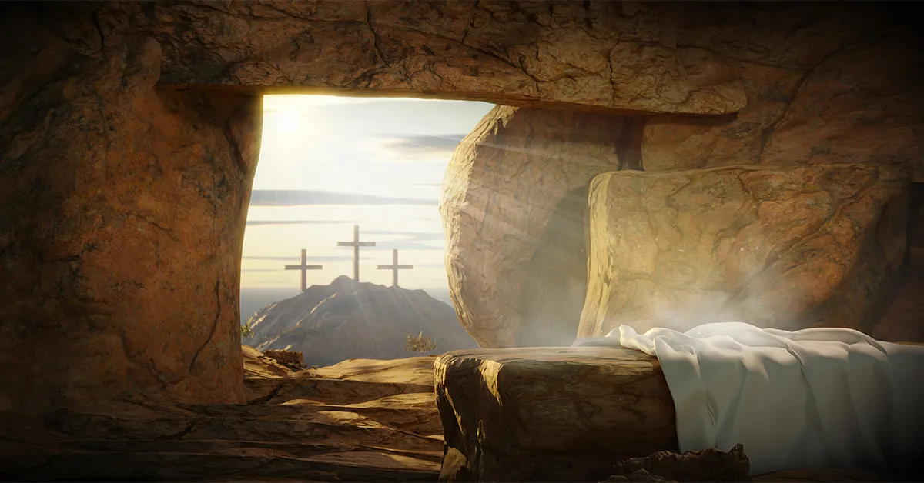
Luke 24: 5-6a
In their fright the women bowed down with their faces to the ground, but the men said to them, “Why do you look for the living among the dead? He is not here; he has risen!”
Week of April 1
Notes:
April 1

Slide 3
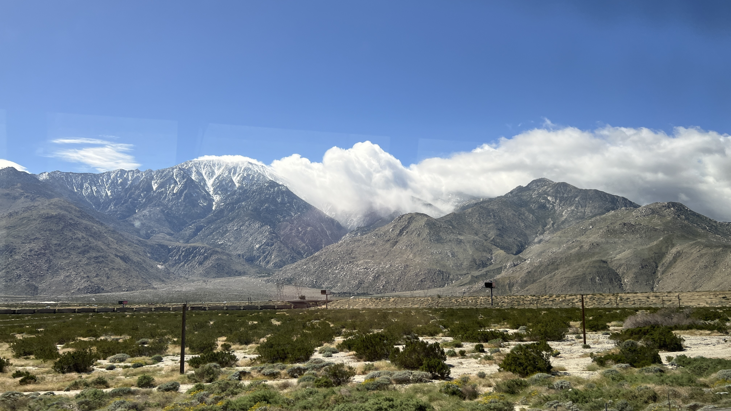
Road to Emmaus
Luke 24: 30-32
When he was at the table with them, he took bread, gave thanks, broke it and began to give it to them. Then their eyes were opened and they recognized him, and he disappeared from their sight. They asked each other, “Were not our hearts burning within us while he talked with us on the road and opened the Scriptures to us?”
Week of April 8
Southern California, USA March 2024
Notes:
April 8

Slide 4
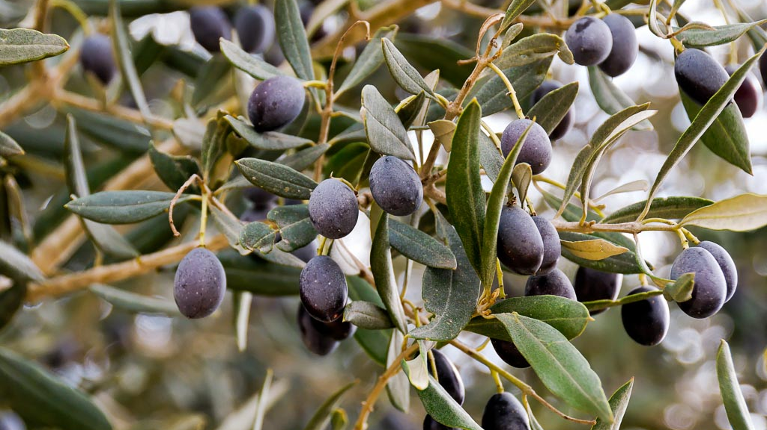
Jesus Appears to His Disciples
Luke 24: 45-47
Then he opened their minds so they could understand the Scriptures. He told them, “This is what is written: The Messiah will suffer and rise from the dead on the third day, and repentance for the forgiveness of sins will be preached in his name to all nations, beginning at Jerusalem.
Week of April 15
@BiblePlaces.com
Notes:
April 15

Slide 5
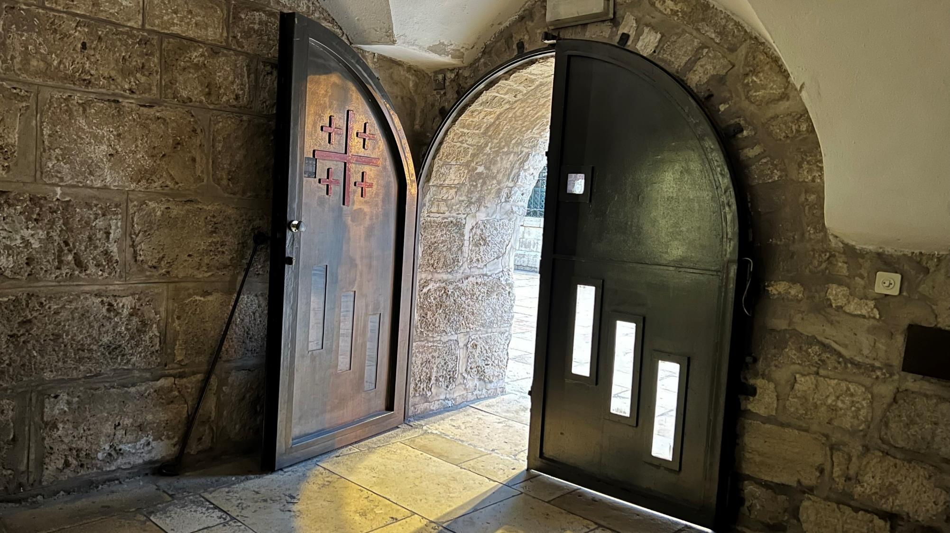
Jesus Appears
to the Disciples
John 20: 21-22
Again Jesus said, “Peace be with you! As the Father has sent me, I am sending you.” And with that he breathed on them and said, “Receive the Holy Spirit.
Week of April 22
Church of the Nativity, Bethlehem, Israel – Pentecost Sunday May 28, 2023
Notes:
April 22

Slide 6
Jesus Reinstates Peter
John 21: 17
The third time he said to him, “Simon son of John, do you love me?”
Peter was hurt because Jesus asked him the third time, “Do you love me?” He said, “Lord, you know all things; you know that I love you.”
Jesus said, “Feed my sheep…”
Week of April 26
Sea of Galilee at Sunrise June 2023
Notes:
April 29

Slide 7
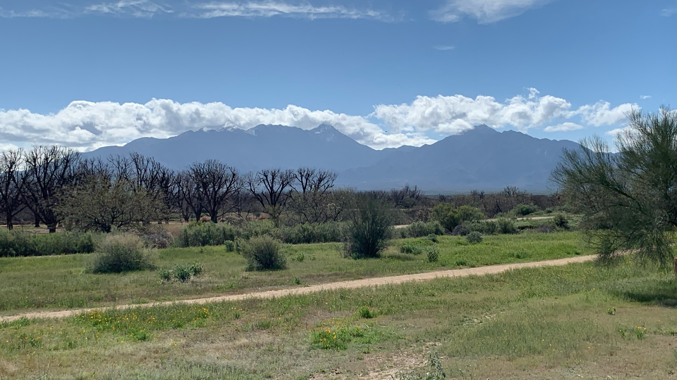
The Great Commission
Matthew 28: 19-20
Therefore go and make disciples of all nations, baptizing them in the name of the Father and of the Son and of the Holy Spirit, and teaching them to obey everything I have commanded you. And surely I am with you always, to the very end of the age.”
Week of May 6
Santa Rita Mountains, Green Valley, Arizona, USA March 2024
Notes:
May 6

Slide 8
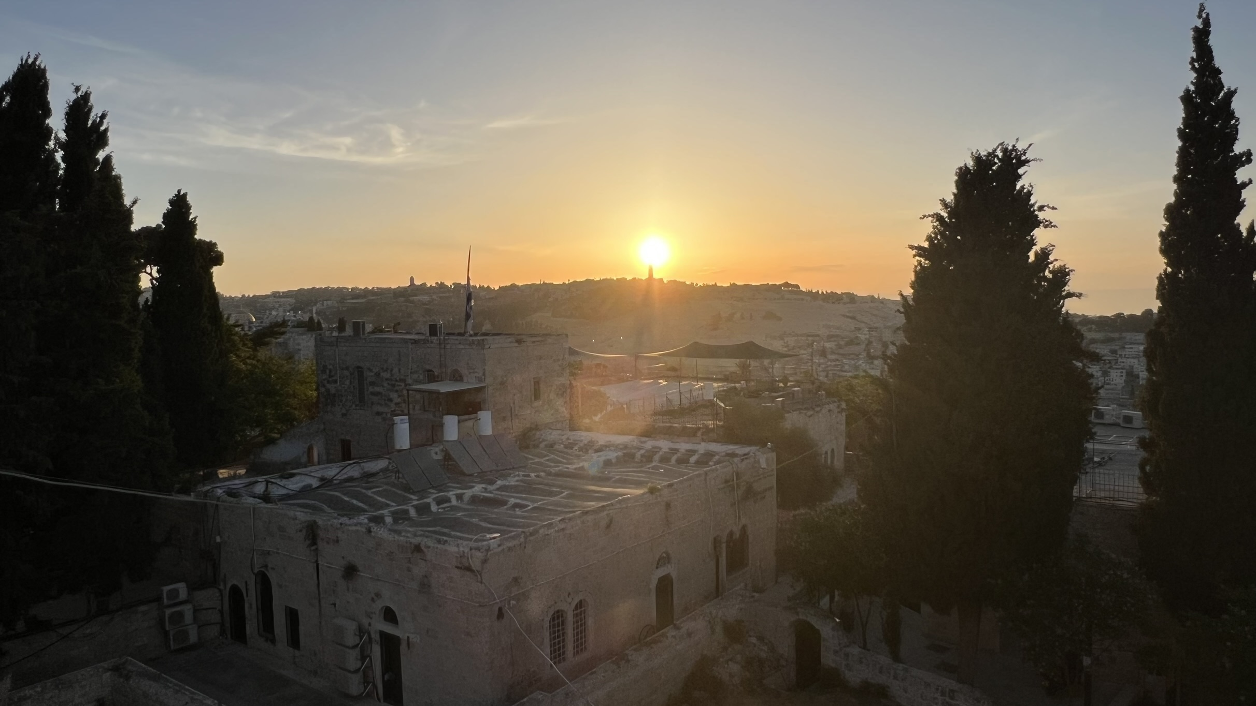
Ascension of Jesus
Acts 1: 7-9
He said to them: “It is not for you to know the times or dates the Father has set by his own authority. But you will receive power when the Holy Spirit comes on you; and you will be my witnesses in Jerusalem, and in all Judea and Samaria, and to the ends of the earth.”
After he said this, he was taken up before their very eyes, and a cloud hid him from their sight.
Week of May 13
Jerusalem, looking east at sunrise over the Mount of Olives at spire of the “Church of the Ascension” June 2023
Notes:
May 13

Slide 9
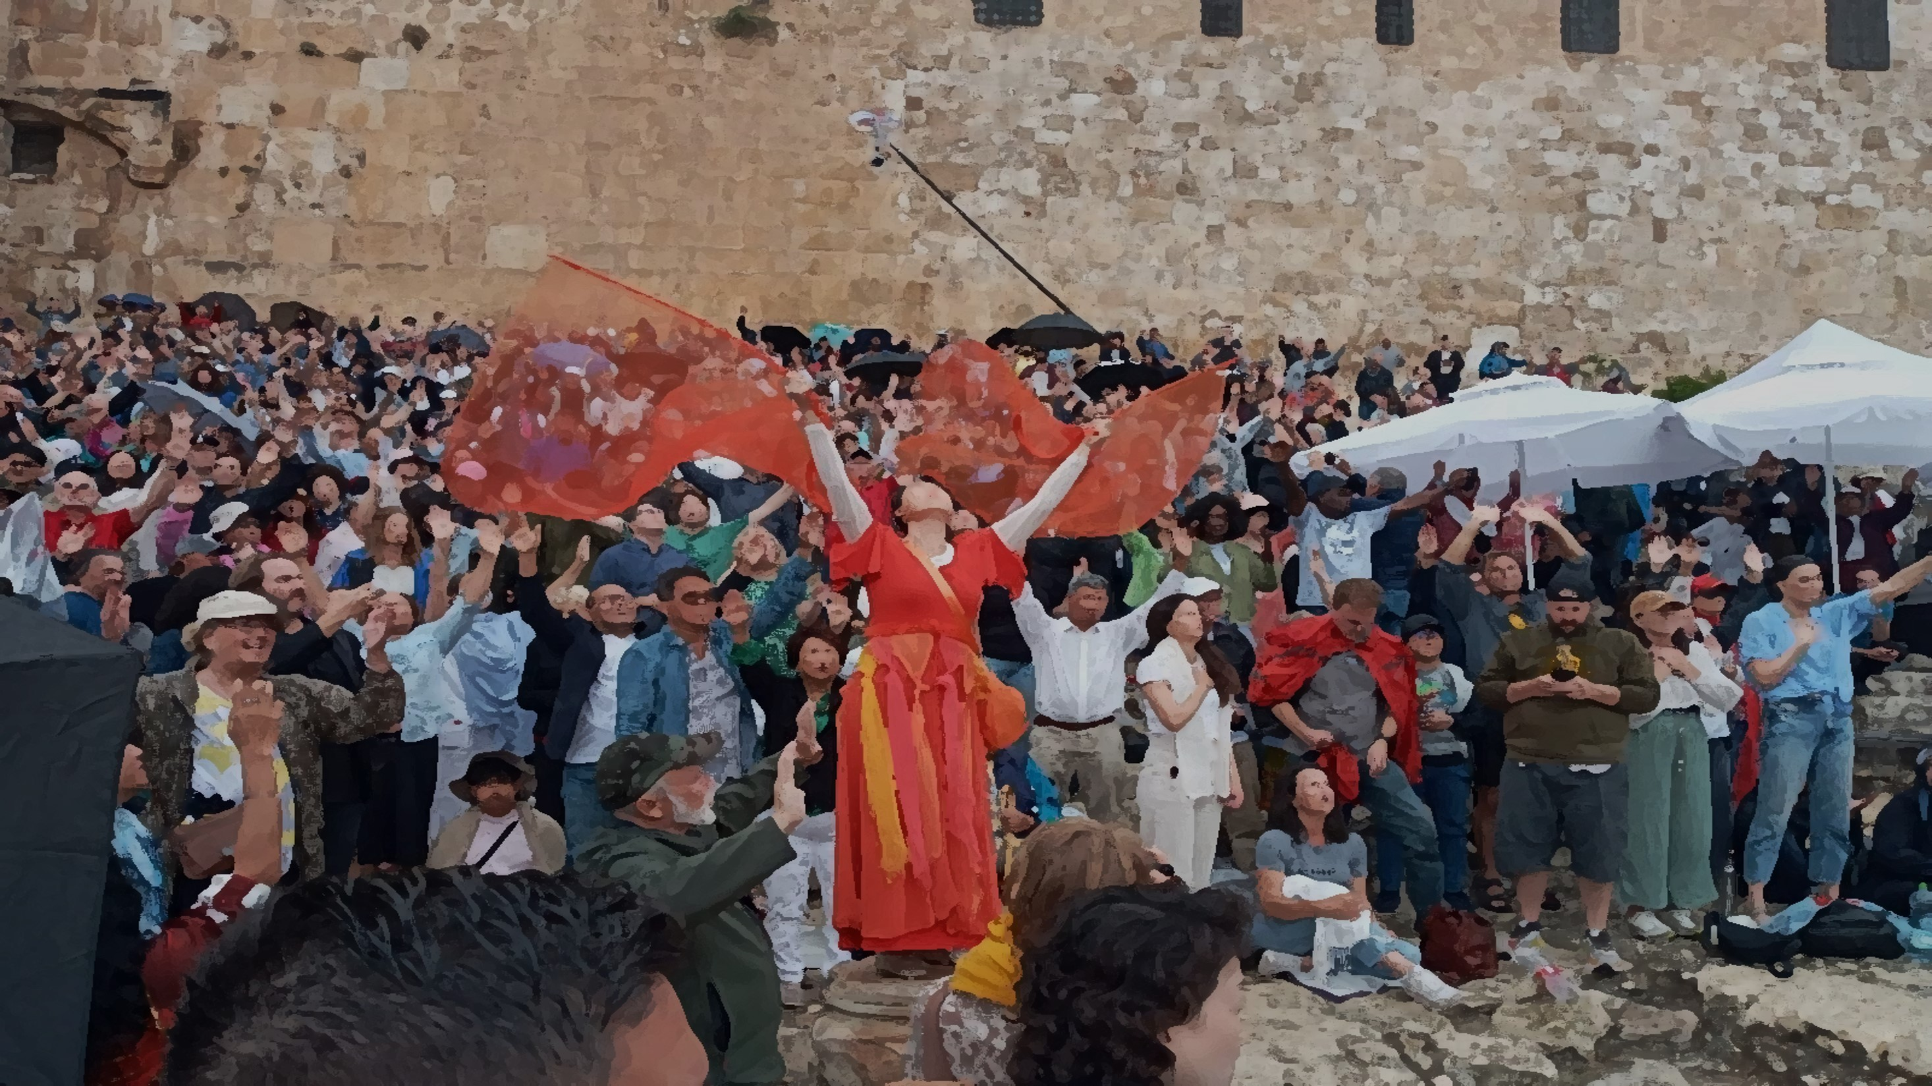
The Gift of the Holy Spirit
Acts 2:38
Peter replied, “Repent and be baptized, every one of you, in the name of Jesus Christ for the forgiveness of your sins. And you will receive the gift of the Holy Spirit.”
Week of May 20
Jerusalem, Southern Steps on Temple Mound – Pentecost Sunday May 28, 2023
Notes:
May 20

Slide 10
No Prayer Meetings on May 27th
In observance of the U.S. Memorial Day

Slide 11

Psalm 51: 10-12
Create in me a pure heart, O God, and renew a steadfast spirit within me. Do not cast me from your presence or take your Holy Spirit from me. Restore to me the joy of your salvation and grant me a willing spirit, to sustain me.
Friday, May 31

Slide 12
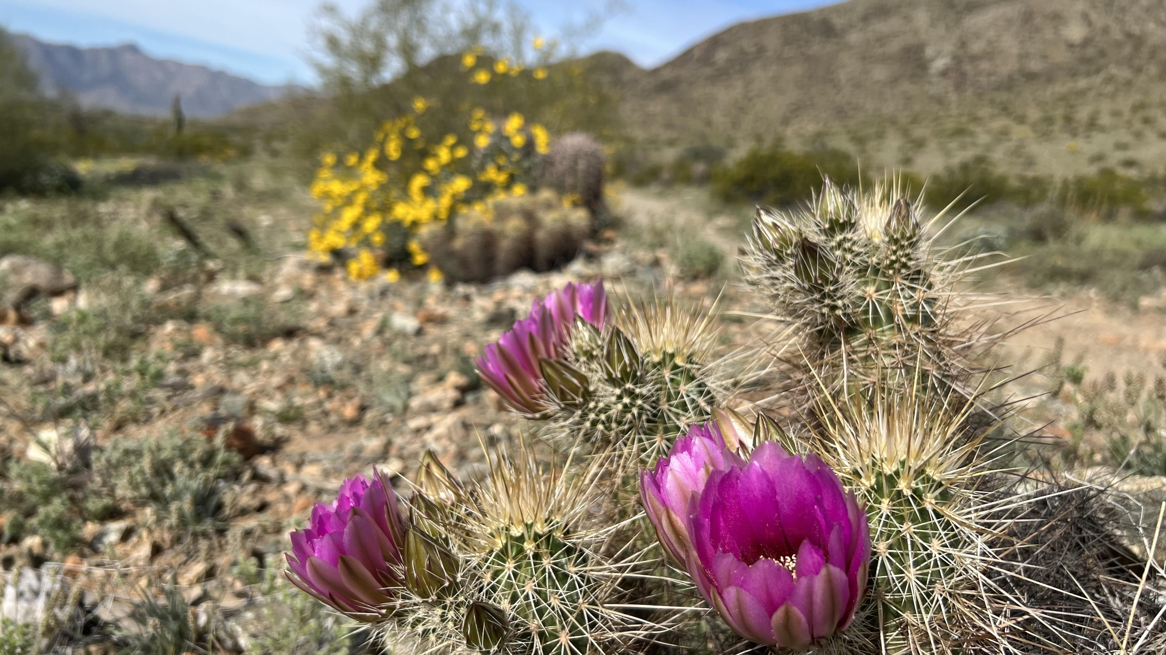
Jesus is Our Salvation
Acts 4:12
Salvation is found in no one else, for there is no other name under heaven given to mankind by which we must be saved.
Week of June 3
Notes:
June 3

Slide 13
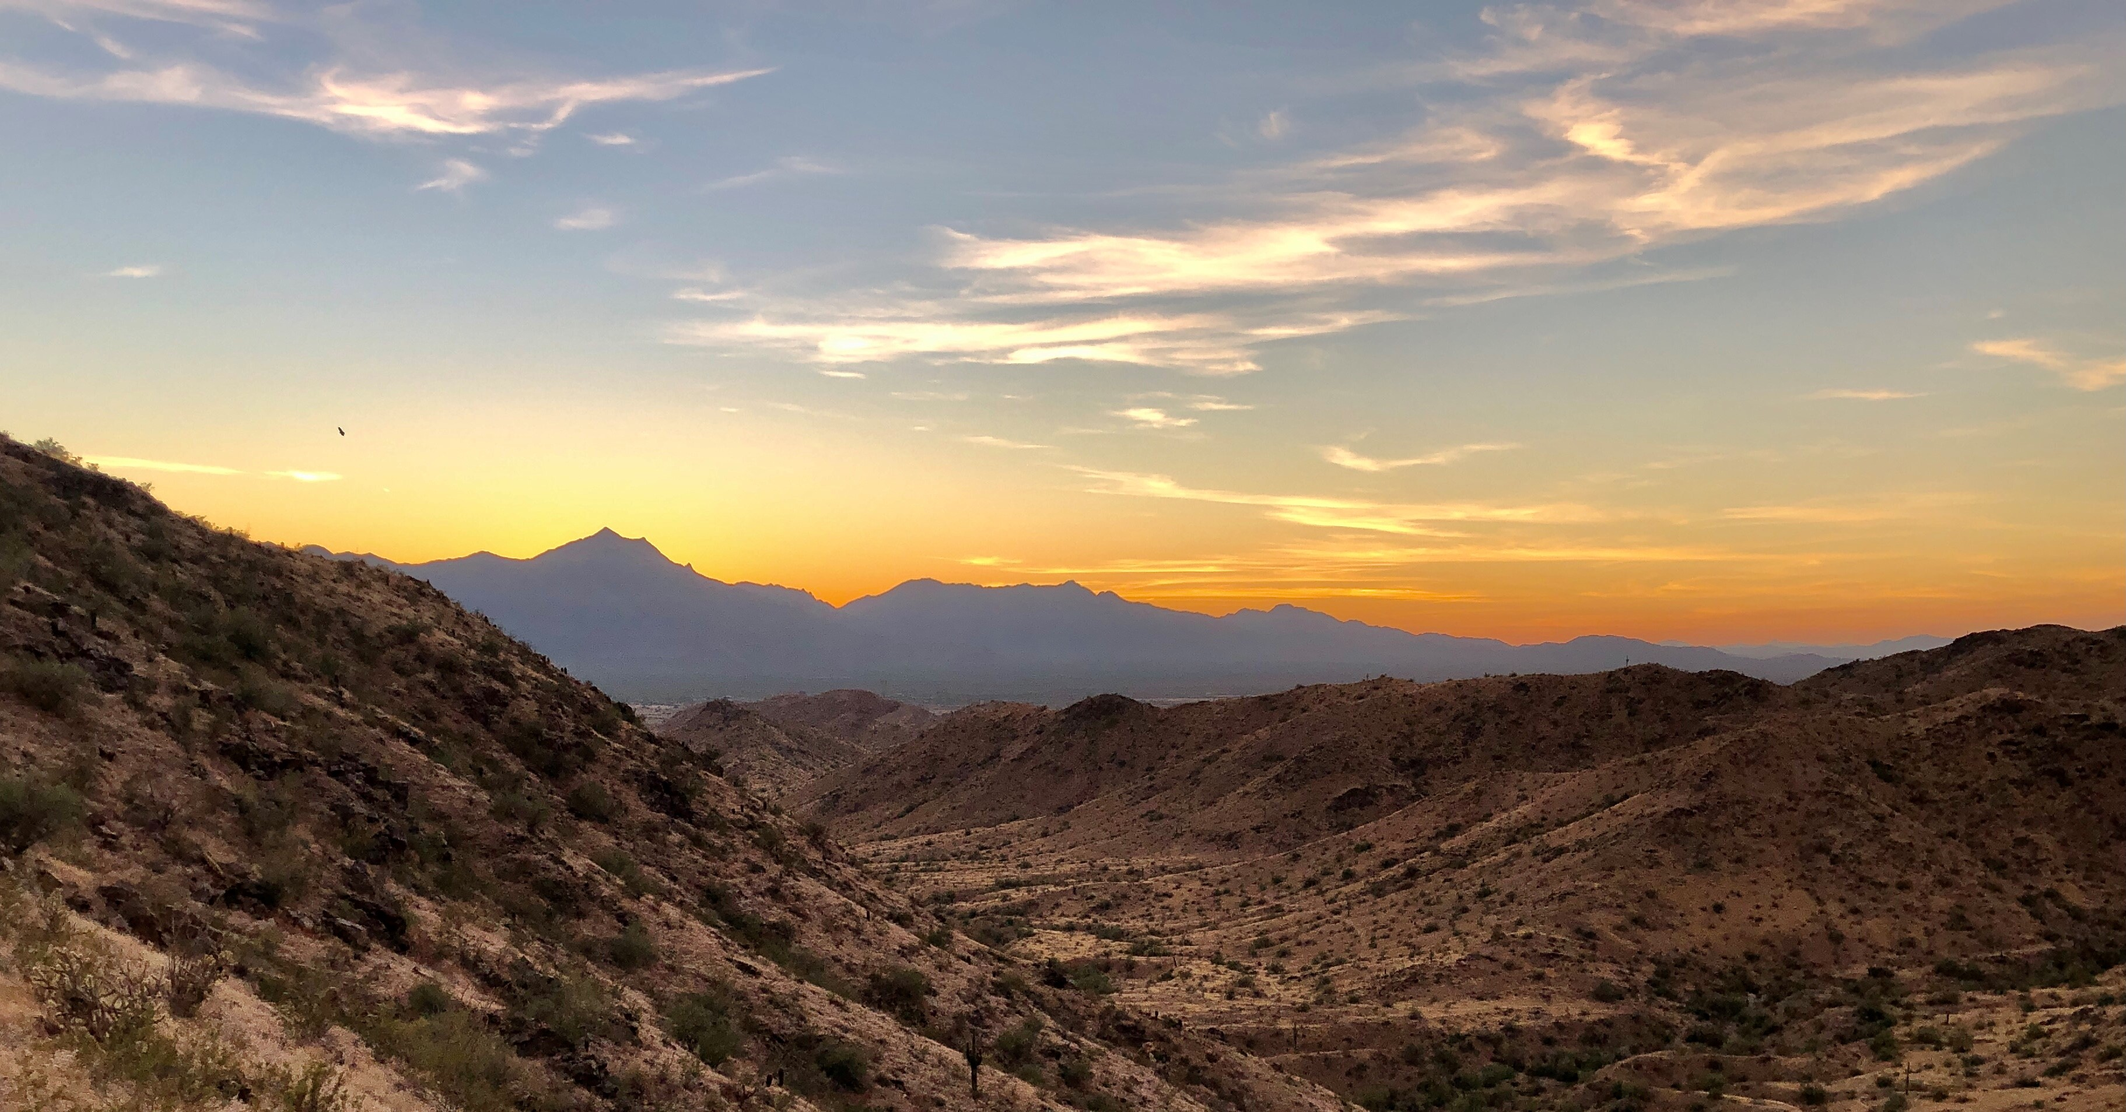
Saul’s Conversion
Even the hardest of hearts can be changed by the power of Jesus.
Acts 9:3-6
As he neared Damascus on his journey, suddenly a light from heaven flashed around him. He fell to the ground and heard a voice say to him, “Saul, Saul, why do you persecute me?” “Who are you, Lord?” Saul asked. “I am Jesus, whom you are persecuting,” he replied. “Now get up and go into the city, and you will be told what you must do.”
Week of June 10
Notes:
June 10

Slide 14
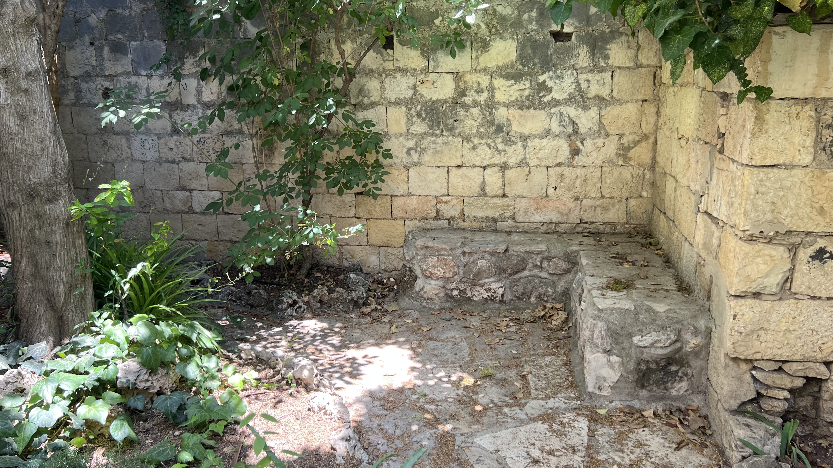
The Apostles Share the Good News
Jesus called them to follow, and in doing so, they shared God’s love abundantly and with great joy.
Acts 5:42
Day after day, in the temple courts and from house to house, they never stopped teaching and proclaiming the good news that Jesus is the Messiah.
Week of June 17
Notes:
June 17

Slide 15
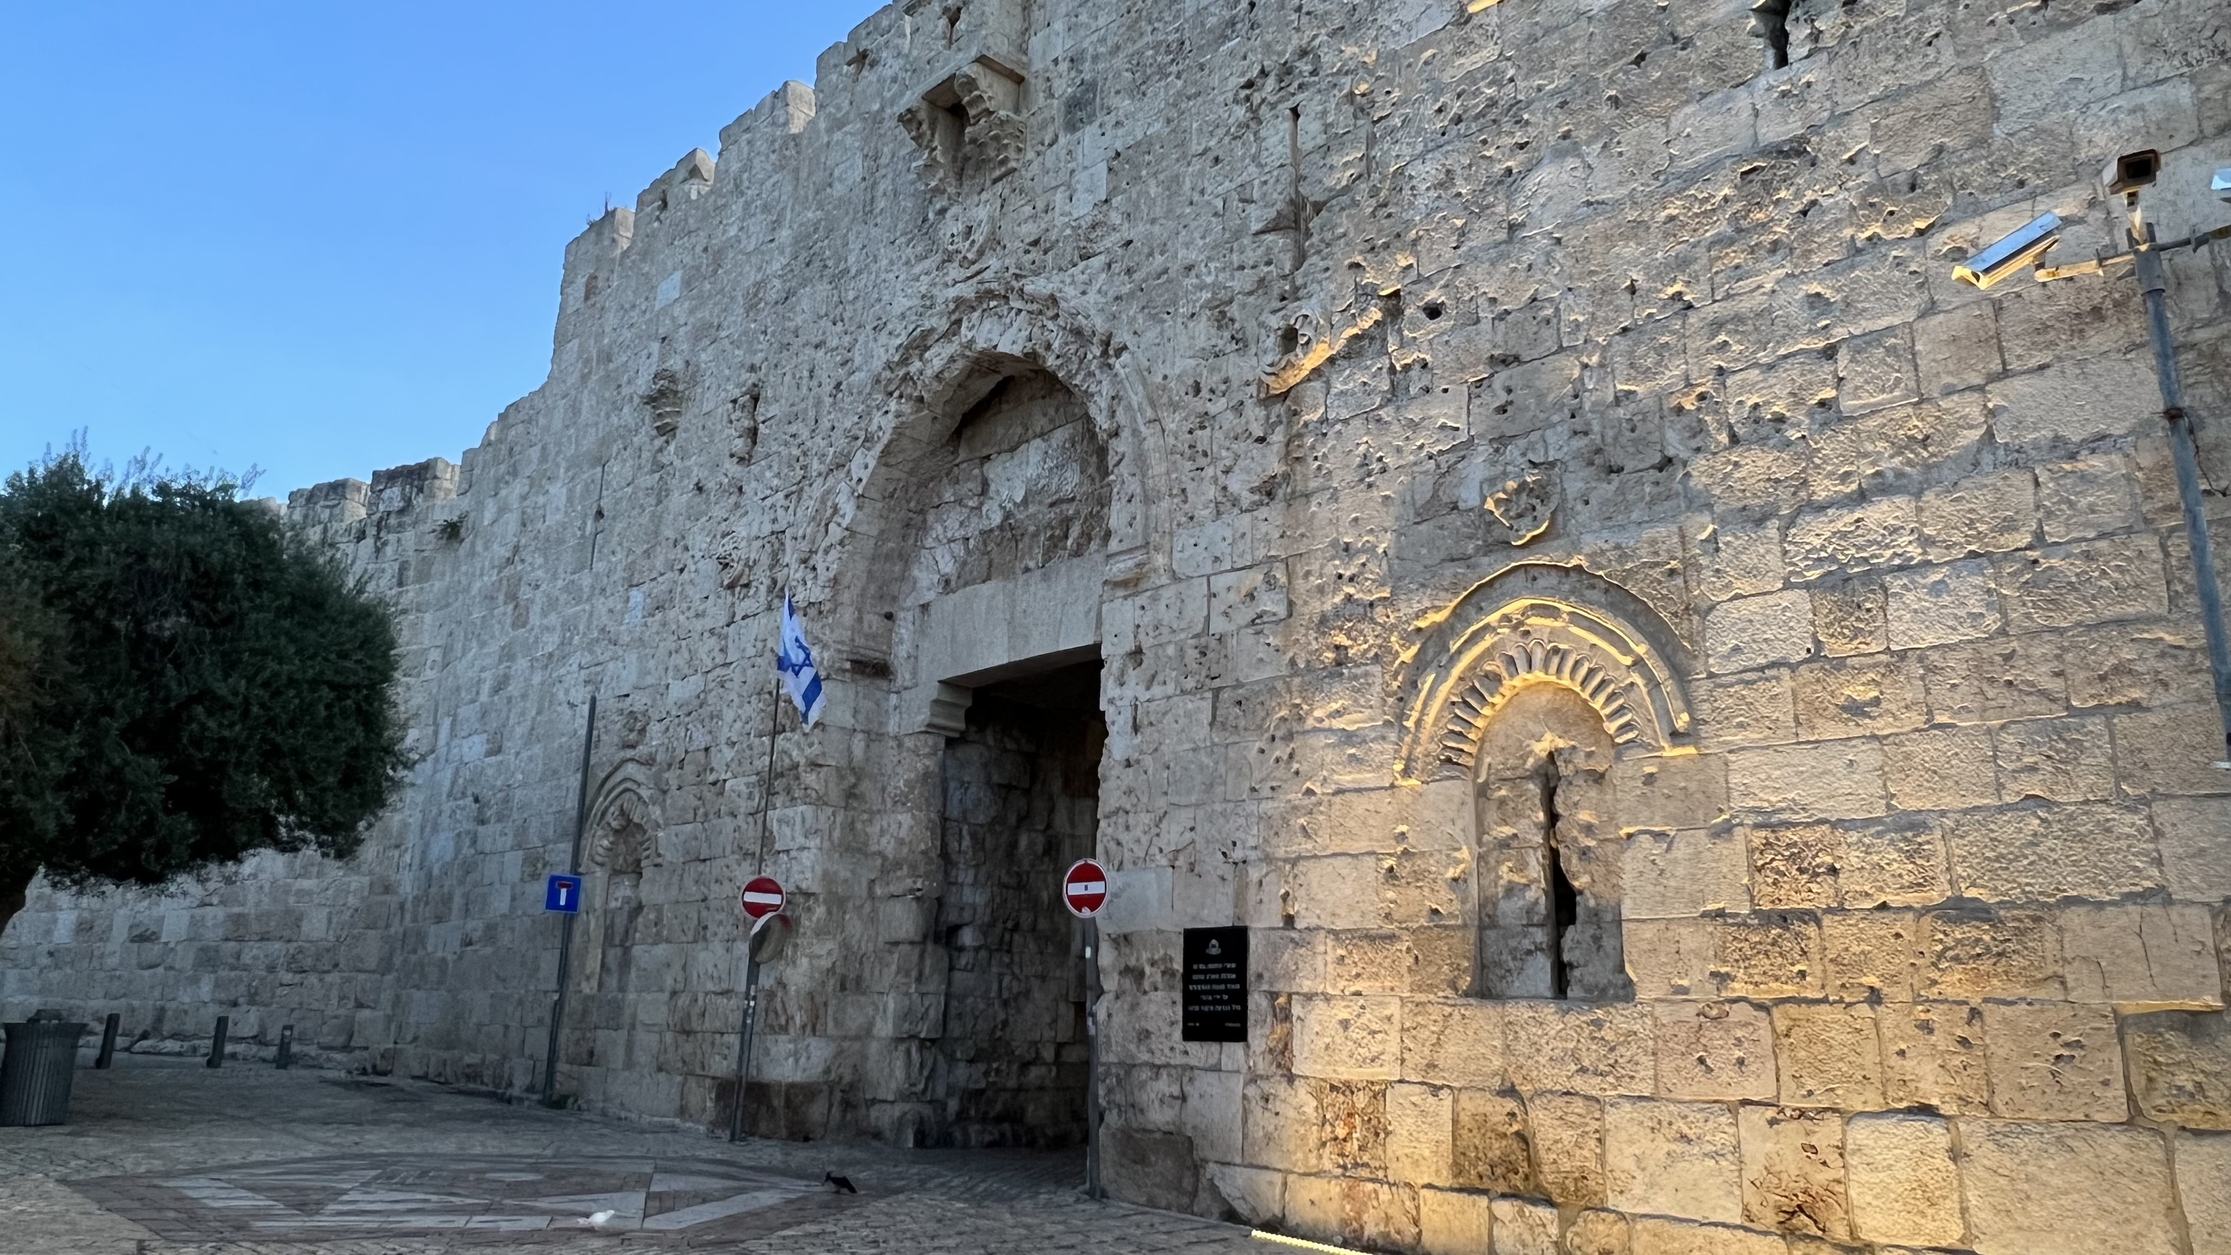
Paul Courageously Preaches the Gospel
God goes before us, that we may boldly proclaim the gospel.
Acts 18:9-11
One night the Lord spoke to Paul in a vision: “Do not be afraid; keep on speaking, do not be silent. For I am with you, and no one is going to attack and harm you, because I have many people in this city.” So Paul stayed in Corinth for a year and a half, teaching them the word of God.
Week of June 24
Notes:
June 24

