Slide 1

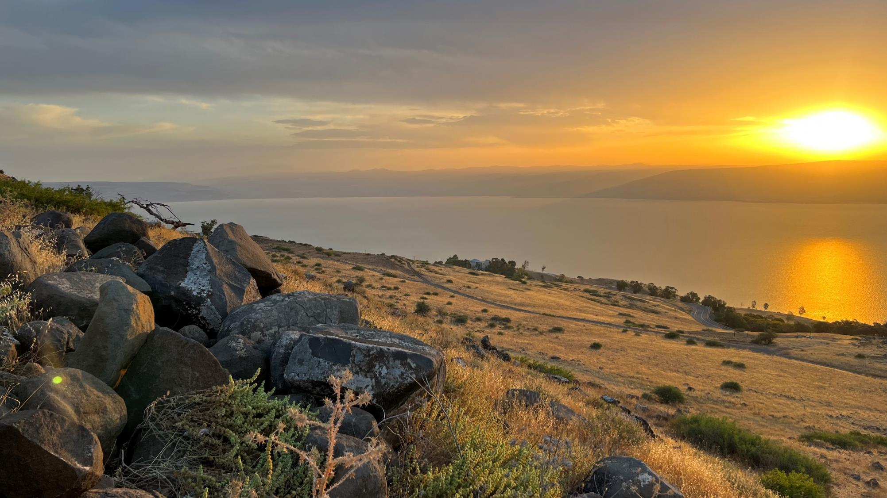
Welcome to: MARKETPLACE PRAYER!
All prayer is focused on the marketplace, people at work
No politics
Respect differences in Christian beliefs/traditions
Pray bold, audacious prayers! Our God is BIG and He desires to change the world with His LOVE!
AGENDA:
Bible Verse/Praise – Open (3-5min)
Listen to God – Quiet Time (3-5min)
Pray for Marketplace – Open (~15min)
COURAGE = Action in spite of fear.
THIRD = Third place. God first, Others second, I am THIRD.
Sea of Galilee at Sunrise, Israel

Slide 2
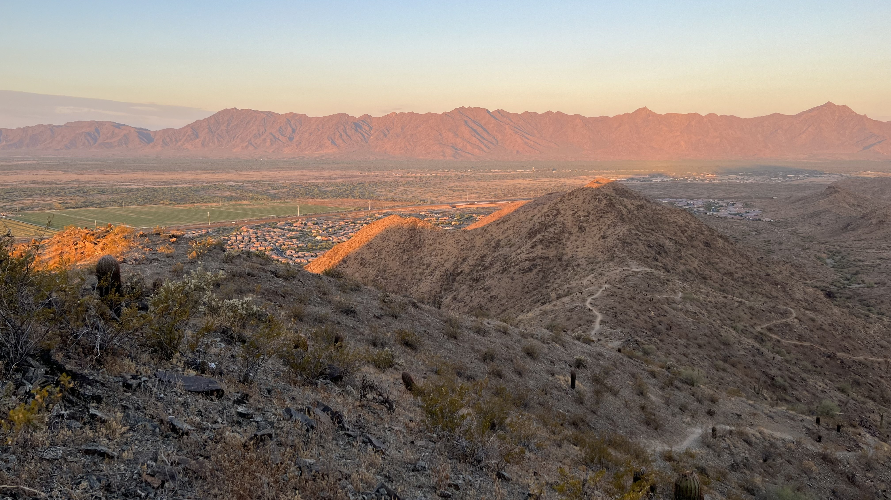
Psalm 113: 2-4
Let the name of the Lord be praised, both now and forevermore. From the rising of the sun to the place where it sets, the name of the Lord is to be praised. The Lord is exalted over all the nations, his glory above the heavens.
South Mountain, Phoenix, Arizona USA
Notes:
Week of Jan. 8

Slide 3
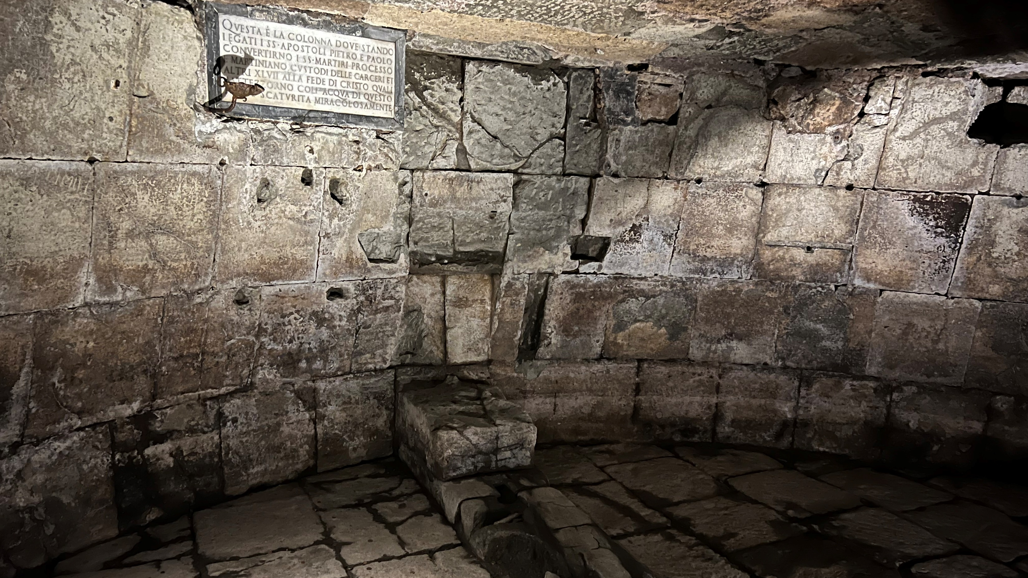
Colossians 3:12-14
Therefore, as God’s chosen people, holy and dearly loved, clothe yourselves with compassion, kindness, humility, gentleness and patience. Bear with each other and forgive one another if any of you has a grievance against someone. Forgive as the Lord forgave you. And over all these virtues put on love, which binds them all together in perfect unity.
Where Apostles Paul and Peter spent their last days before dying, Mamertine Prison, Rome, Italy
Notes:
Week of Jan. 15

Slide 4
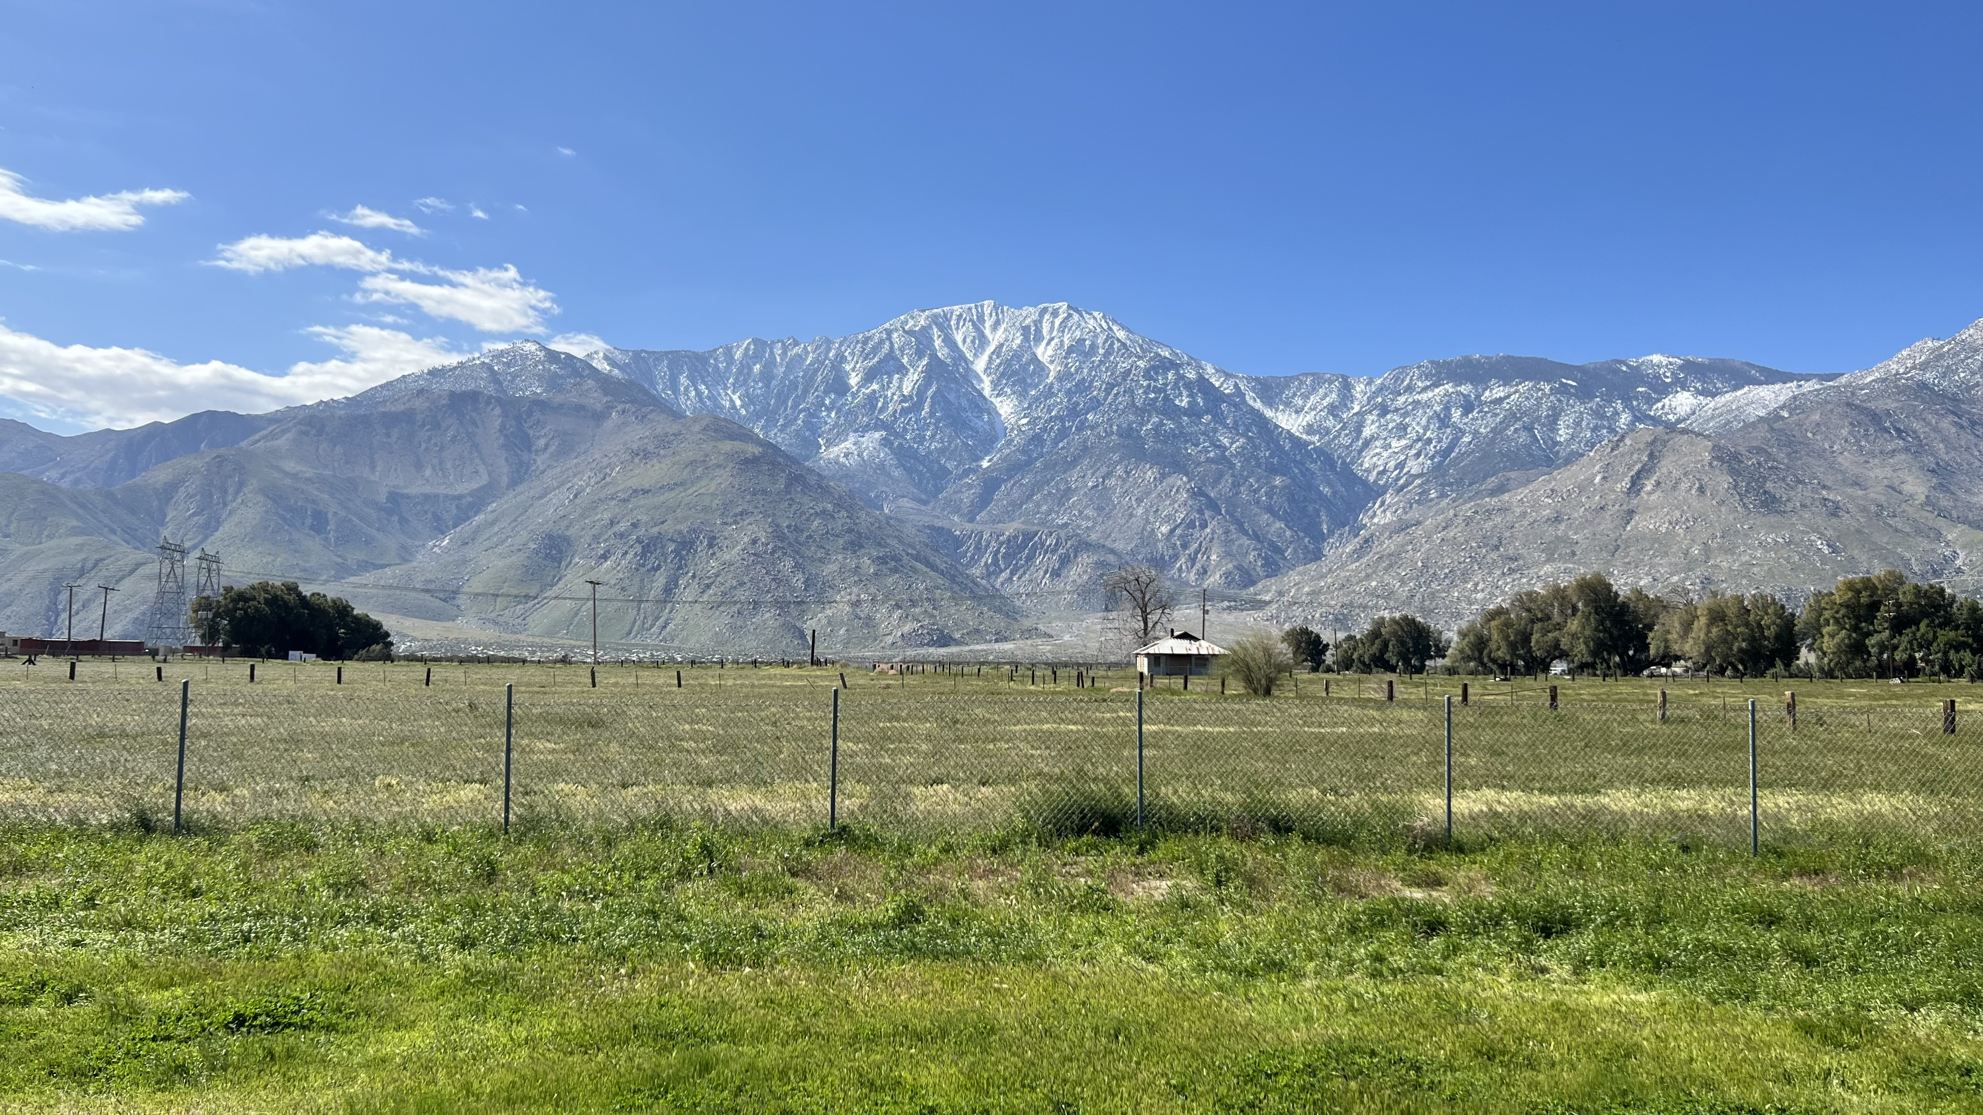
Isaiah 26: 2-4
Open the gates that the righteous nation may enter, the nation that keeps faith. You will keep in perfect peace those whose minds are steadfast, because they trust in you. Trust in the Lord forever, for the Lord, the Lord himself, is the Rock eternal.
Between Los Angeles and Phoenix, somewhere by the freeway! February 2022
Notes:
Week of Jan. 22

Slide 5
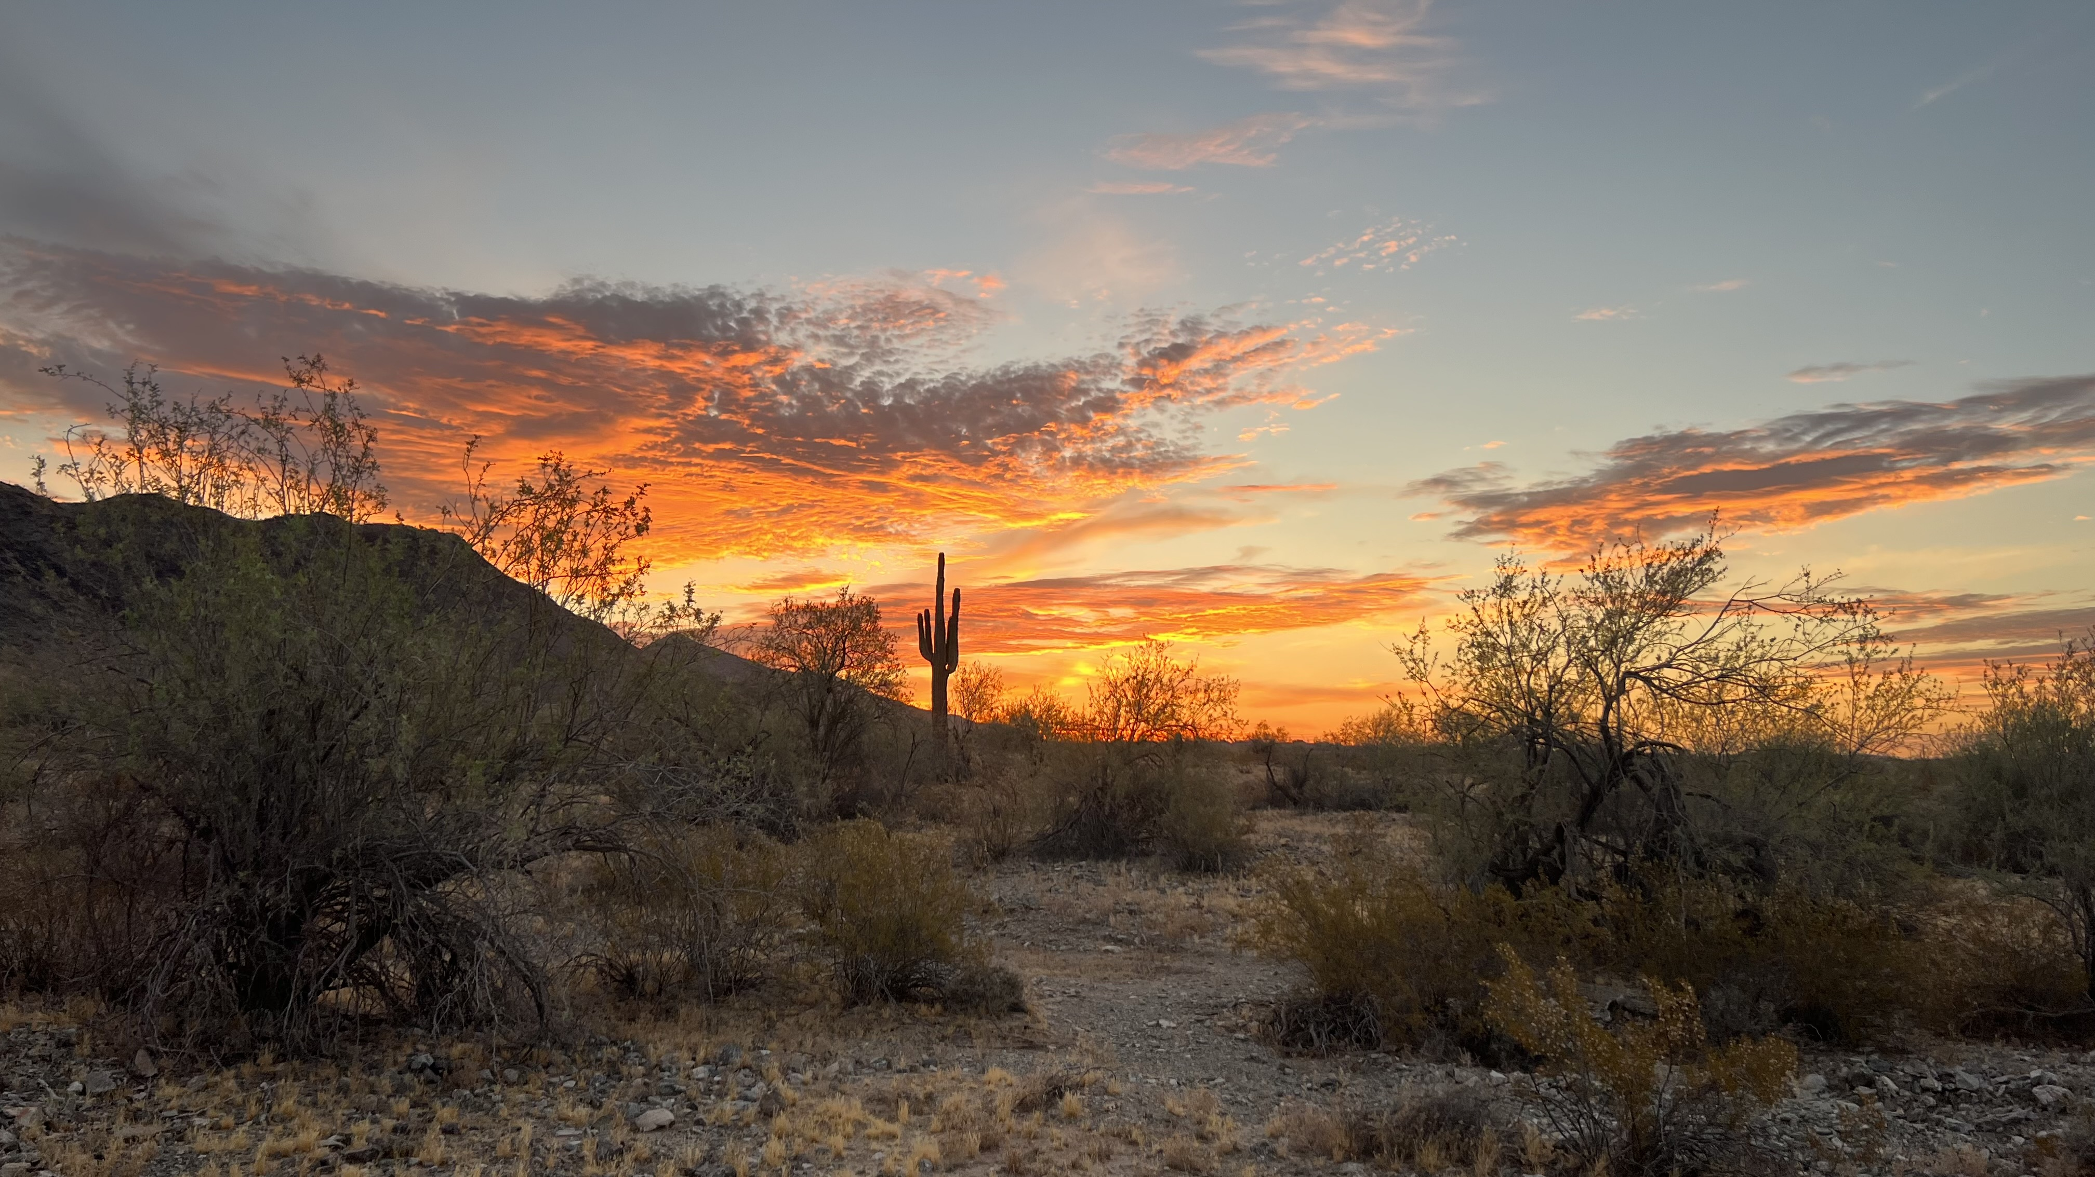
Romans 15: 5-6
May the God who gives endurance and encouragement give you the same attitude of mind toward each other that Christ Jesus had, so that with one mind and one voice you may glorify the God and Father of our Lord Jesus Christ.
Phoenix, Arizona USA
Notes:
Week of Jan. 29

Slide 6
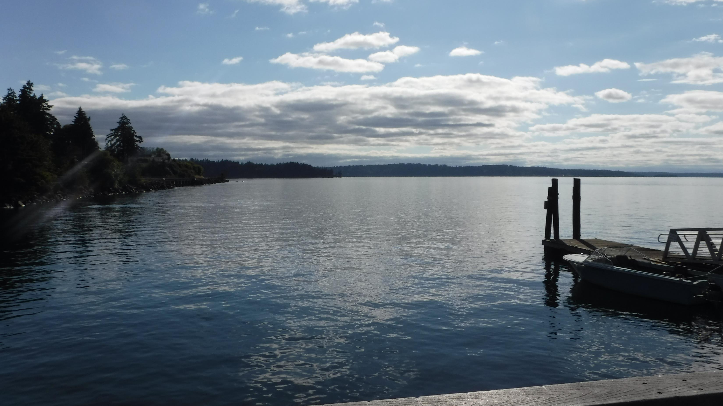
2 Corinthians 1: 3-5
Praise be to the God and Father of our Lord Jesus Christ, the Father of compassion and the God of all comfort, who comforts us in all our troubles, so that we can comfort those in any trouble with the comfort we ourselves receive from God. For just as we share abundantly in the sufferings of Christ, so also our comfort abounds through Christ.
Olympic Peninsula, Washington USA
Notes:
Week of Feb. 5

Slide 7
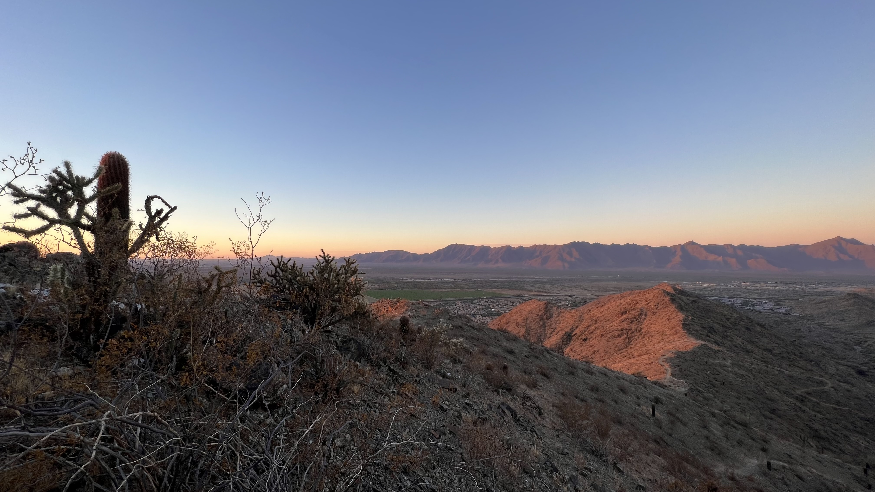
Hebrews 12:14
Make every effort to live in peace with everyone and to be holy; without holiness no one will see the Lord.
South Mountain, Phoenix, Arizona USA
Notes:
Week of Feb. 12

Slide 8
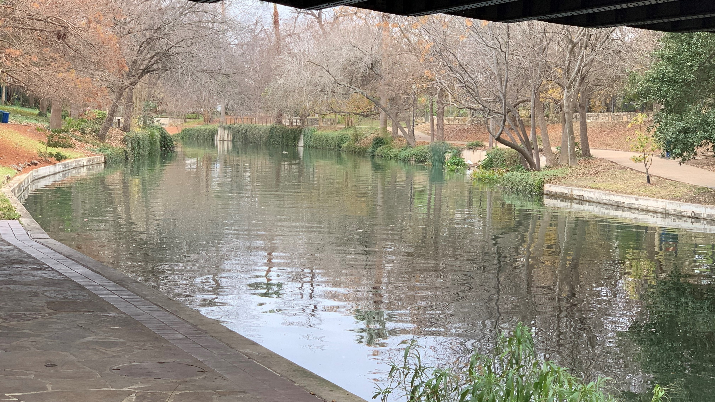
Galatians 3: 14
He redeemed us in order that the blessing given to Abraham might come to the Gentiles through Christ Jesus, so that by faith we might receive the promise of the Spirit.
River Walk, San Antonio, Texas USA
Notes:
Week of Feb. 19

Slide 9
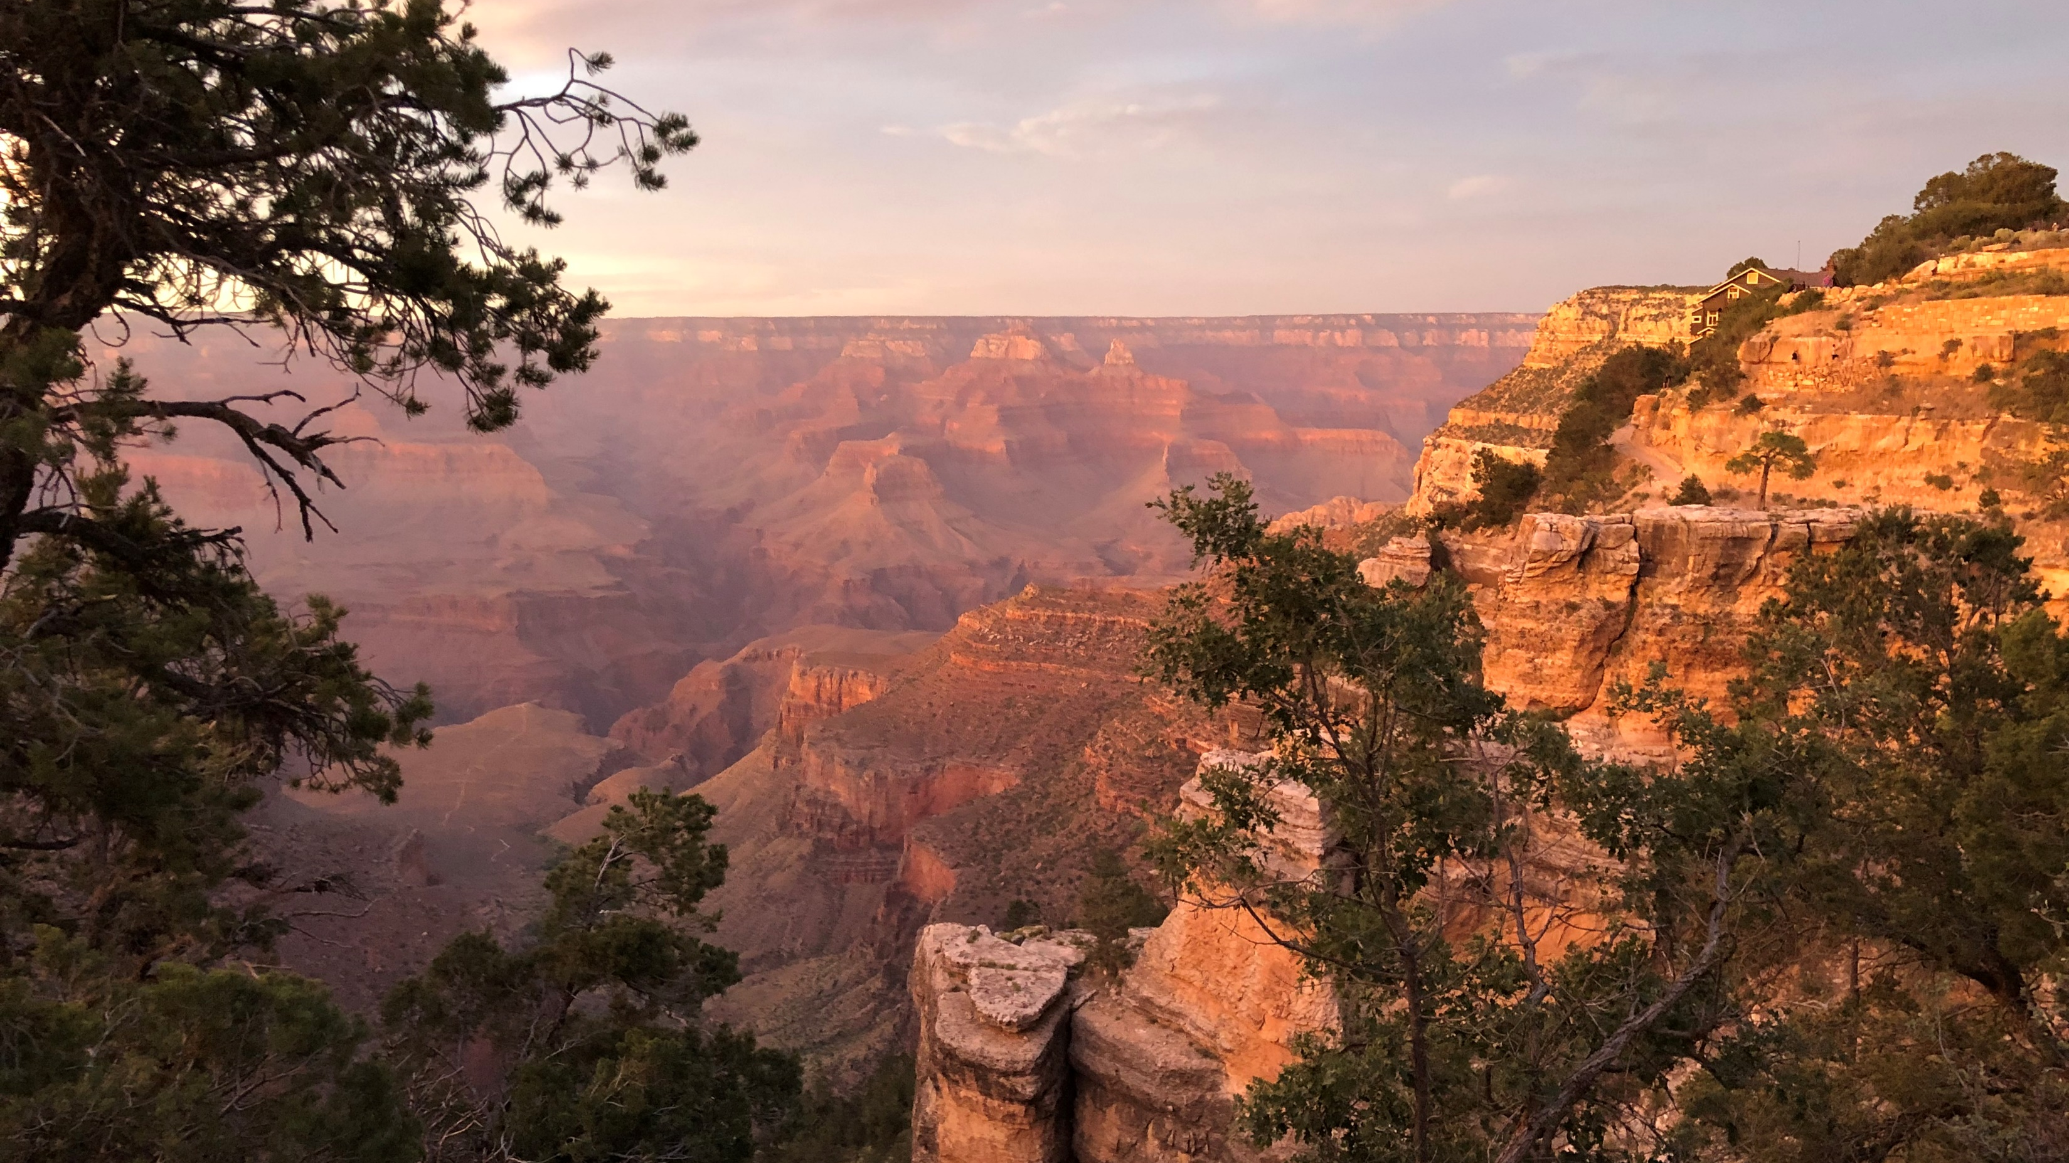
Philippians 2: 3-4
Do nothing out of selfish ambition or vain conceit. Rather, in humility value others above yourselves, not looking to your own interests but each of you to the interests of the others.
Grand Canyon, Arizona USA
Notes:
Week of Feb. 26

Slide 10
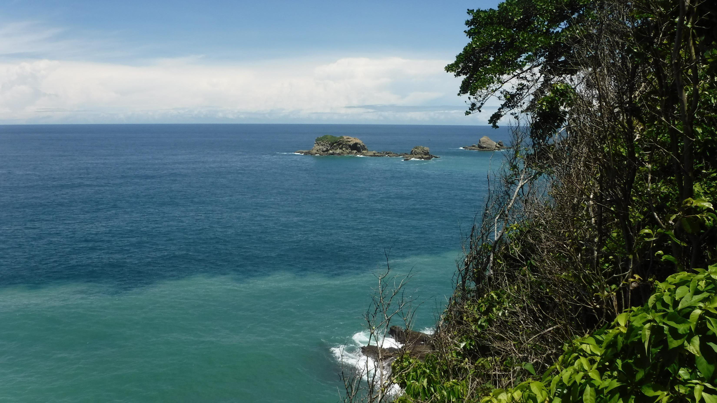
Deuteronomy 6: 5-7
Love the Lord your God with all your heart and with all your soul and with all your strength. These commandments that I give you today are to be on your hearts. Impress them on your children. Talk about them when you sit at home and when you walk along the road, when you lie down and when you get up.
Manuel Antonio, Costa Rica
Notes:
Week of Mar. 4

Slide 11
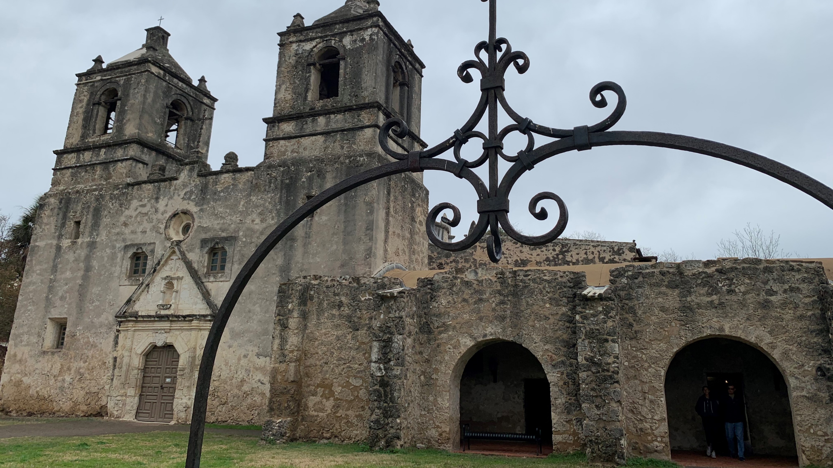
Hebrews 13: 20-21
Now may the God of peace, who through the blood of the eternal covenant brought back from the dead our Lord Jesus, that great Shepherd of the sheep, equip you with everything good for doing his will, and may he work in us what is pleasing to him, through Jesus Christ, to whom be glory for ever and ever. Amen.
Mission Concepcion, San Antonio, Texas USA
Notes:
Week of Mar. 11

Slide 12
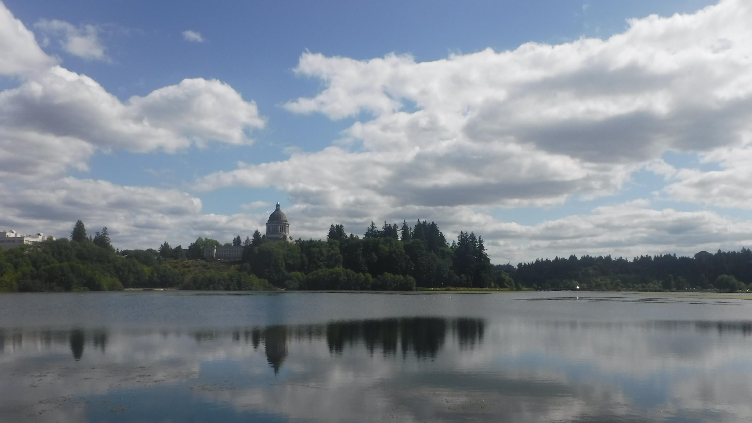
1 Chronicles 16: 8-10
Give praise to the Lord, proclaim his name; make known among the nations what he has done. Sing to him, sing praise to him; tell of all his wonderful acts. Glory in his holy name; let the hearts of those who seek the Lord rejoice.
Olympia, Washington USA
Notes:
Week of Mar. 18

Slide 13
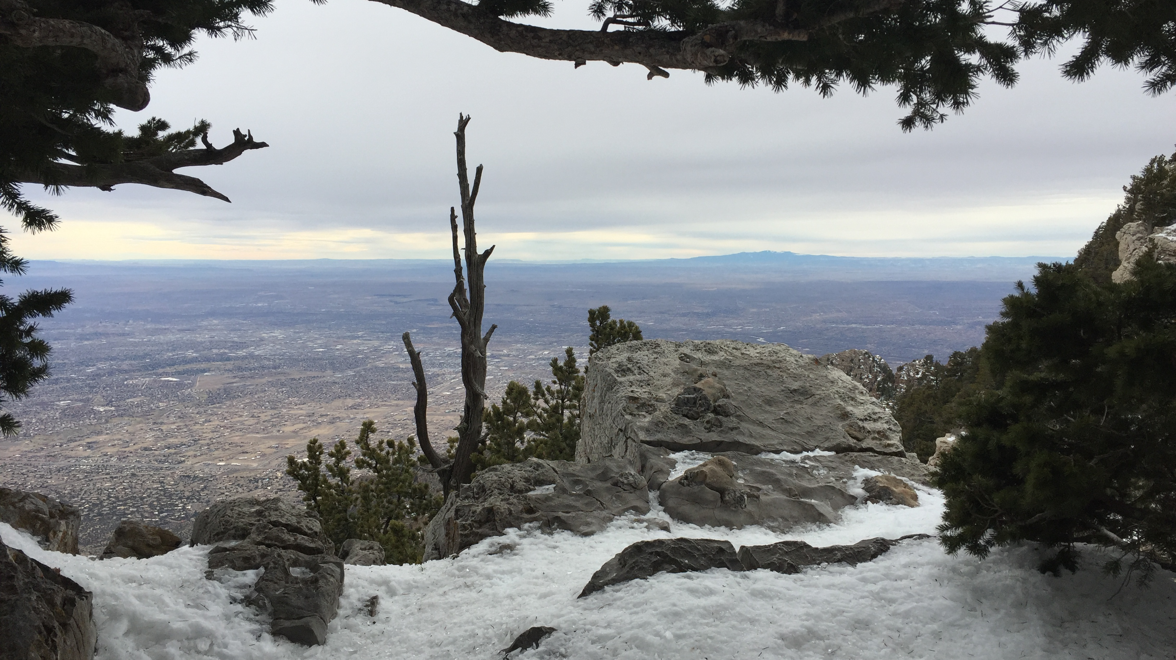
Psalm 91: 1-2
Whoever dwells in the shelter of the Most High will rest in the shadow of the Almighty. I will say of the Lord, “He is my refuge and my fortress, my God, in whom I trust.”
Sandia Mountain, New Mexico USA
Notes:
Week of Mar. 25

Slide 14
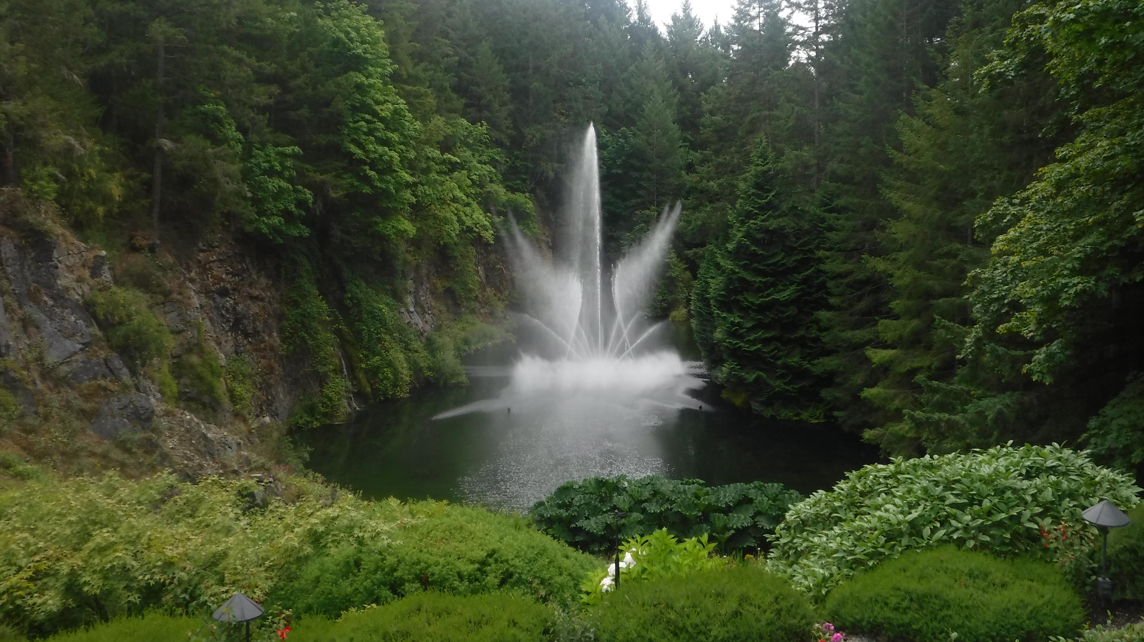
1 Corinthians 16: 13-14
Be on your guard; stand firm in the faith; be courageous; be strong. Do everything in love.
Butchart Gardens, British Columbia, Canada
Notes:
Week of April 1

